Slide 1
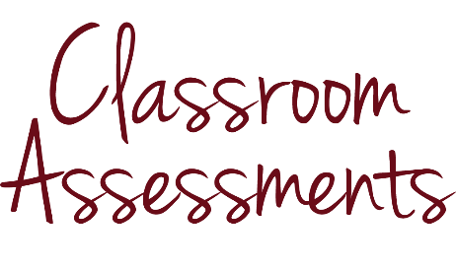
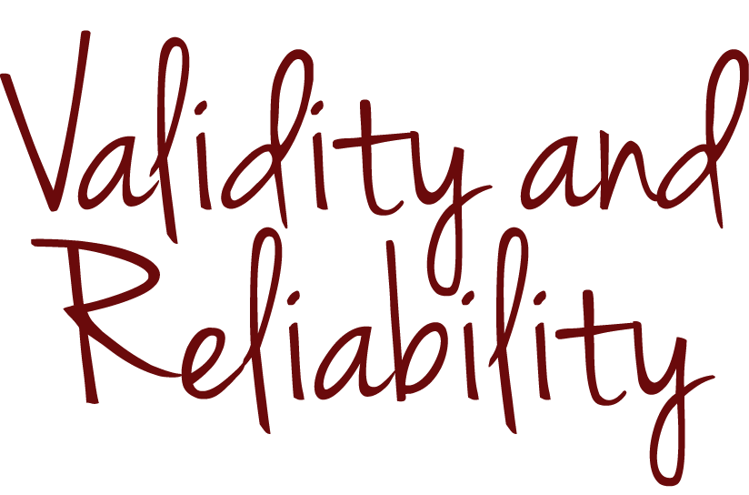
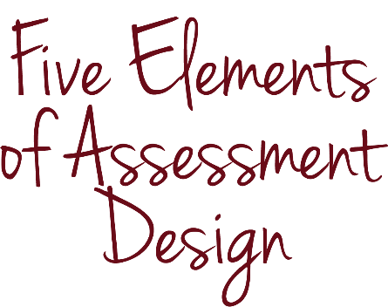
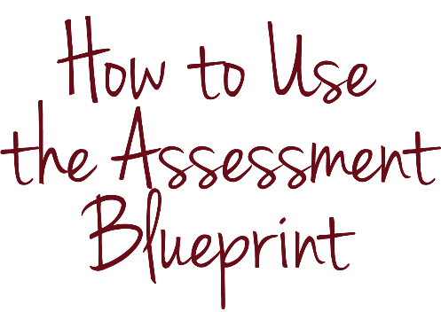
Introduction to
Assessment DESIGN
Notes:
Designing assessments is one of the many complex tasks that teachers take on as professionals.

Slide 2
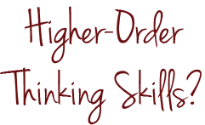
INTRODUCTION & PURPOSE
Notes:
Maybe you designed a 100-question multiple-choice, fill-in-the-blank and true-and-false test to measure your students’ understanding of Homer’s The Odyssey, but you aren’t sure you measured any higher-order thinking skills. Or maybe you started grading yesterday’s mathematics test only to realize that the kids who chose incorrect answer “c” frankly had good reason to select the wrong answer.

Slide 3
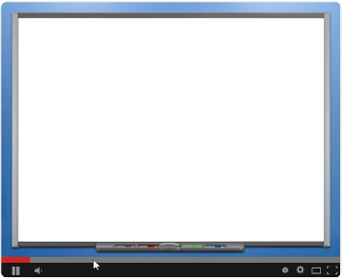
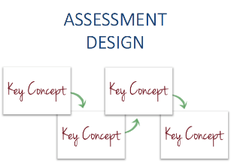
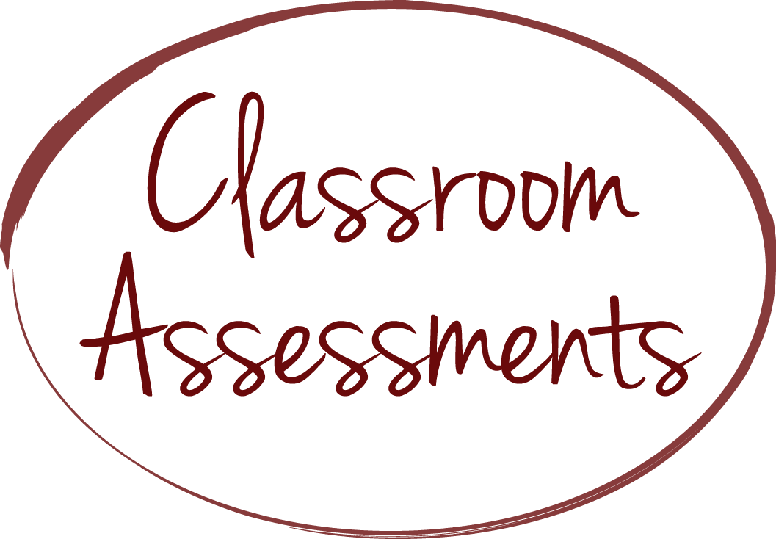
INTRODUCTION & PURPOSE
Notes:
Measuring what students know and can do is an essential part of teaching, and, like much of teaching, designing assessments that measure what we want them to measure is sophisticated work. By completing these modules, you will be able to plan, write and select assessments in which you are confident and that give you a clear sense of what your students are learning.

Slide 4
INTRODUCTION & PURPOSE
Notes:
The modules are designed to empower all teachers, pre-kindergarten through grade 12, to become fluent assessment designers so they can do an even better job of helping their students learn the course content throughout the school year.

Slide 5
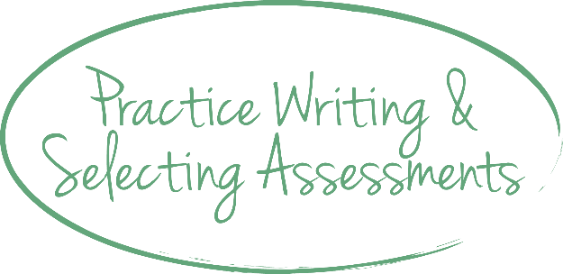
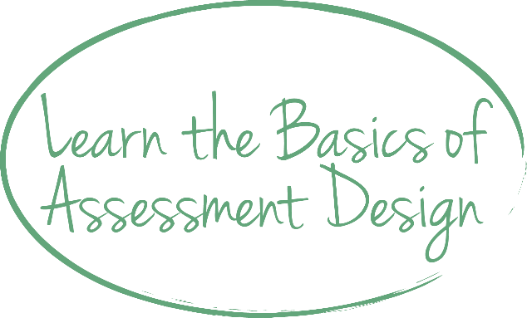
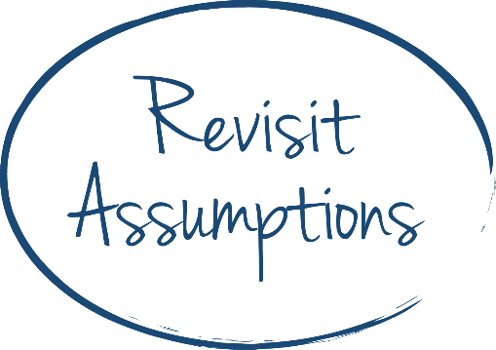
INTRODUCTION & PURPOSE
Notes:
Novice teachers may use the modules to learn the basics about the elements of assessment design and practice writing and selecting assessments. Experienced teachers may use the modules to revisit their assumptions about assessment design and refine what they already do well.

Slide 6
INTRODUCTION & PURPOSE
Notes:
Although we assume that teachers are the primary audience for these modules, principals, assistant principals and central office administrators should benefit from the content as well.

Slide 7
INTRODUCTION & PURPOSE
Define FIVE ELEMENTS OF ASSESSMENT DESIGN AND VALIDITY AND RELIABILITY
Explain WHY teachers should focus on FIVE ELEMENTS OF ASSESSMENT DESIGN
Explain the purpose of the ASSESSMENT BLUEPRINT and the ASSESSMENT BLUEPRINT EXAMPLE
Notes:
Let’s consider what we want you to know and be able to do by the end of this introductory module. By the end of this module, you should be able to define several key terms and concepts that are foundational to this series of modules—including what the modules identify as five elements of assessment design and validity and reliability—and explain why teachers should focus on these five elements of assessment design and not the statistical concepts associated with validity and reliability as researchers and test makers apply them. You will also be able to explain the purpose of two tools that we reference throughout the modules: an assessment blueprint template and an assessment blueprint filled out with an example.

Slide 8
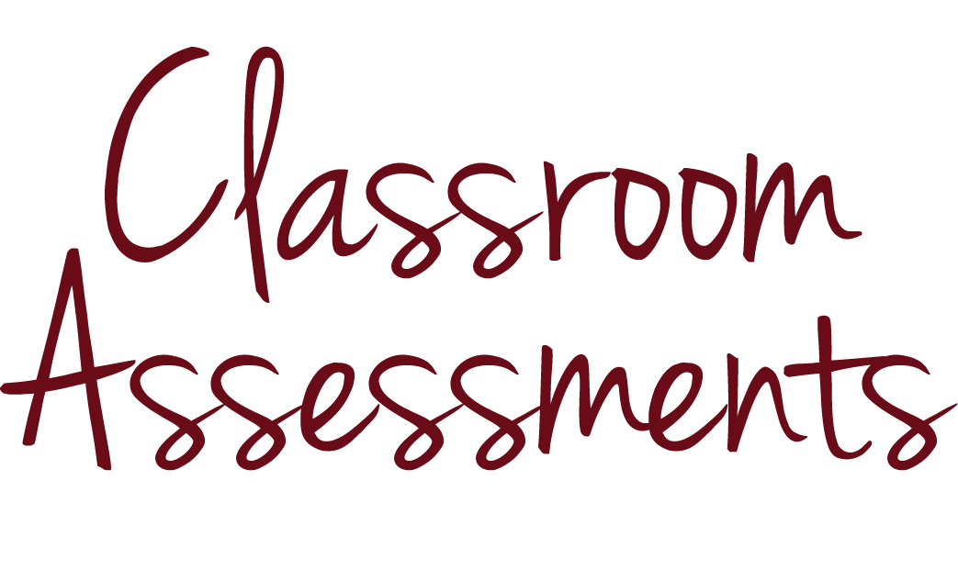
KEY CONCEPTS
Notes:
Now, let’s get started.

Slide 9
KEY CONCEPTS
assessment
processes and tools that measure what students know and can do
?
?
?
?
Notes:
“Assessment” refers to processes and tools that measure what students know and can do. The term includes everything from the questions you ask your students during class discussions to statewide standardized tests.

Slide 10
KEY CONCEPTS
assessment
processes and tools that measure what students know and can do
?
?
?
?
Notes:
During every lesson, you ask questions to assess student knowledge. You may lean over a student’s desk to ask him a question while he works on a mathematics problem, or converse with a small group of students reading the same novel. Skillful teachers use these types of informal checks for understanding to adjust their instruction from moment to moment.

Slide 11
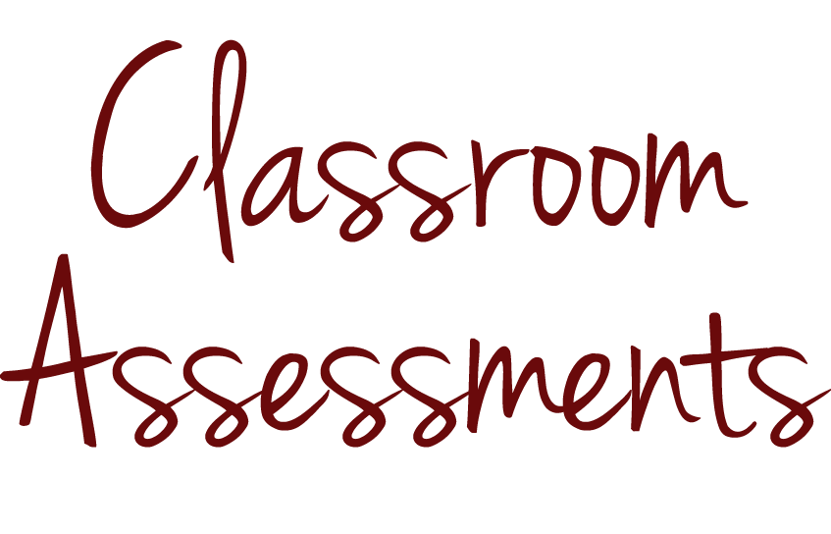
KEY CONCEPTS
?
?
?
?
Notes:
In this series of modules, we focus on a type of assessment that is more formal than these daily checks for understanding but less formal than, for example, an annual State test. We focus on assessments that you design for students in your classroom.

Slide 12
KEY CONCEPTS
assessment design
term that includes planning, writing and selecting assessments
Notes:
For the purposes of these modules, “assessment design” is a term that includes planning, writing and selecting assessments. We consider assessments to be well designed if they provide an accurate and consistent measure of what students know and can do.

Slide 13
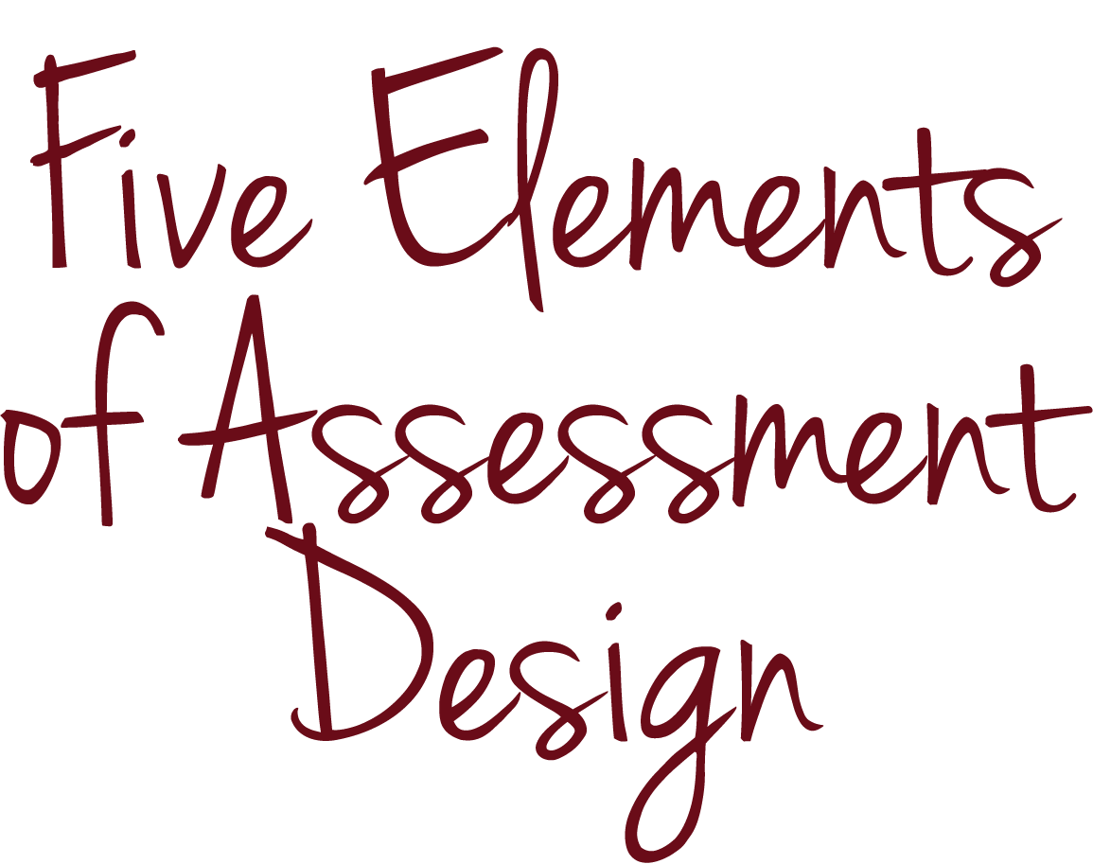
KEY CONCEPTS
Sources: Kansas State Department of Education, Assessment Literacy Project; Ohio Department of Education, “Assessment Literacy: Identifying and Developing Valid and Reliable Assessments” (2013); Relay Graduate School of Education, Designing and Evaluating Assessments (2014); and Rhode Island Department of Education, “Deepening Assessment Literacy.”
Notes:
To determine whether your classroom assessments are well designed, you can consider what we’re calling the “five elements of assessment design.” We suspect that they will sound familiar to you.

Slide 14
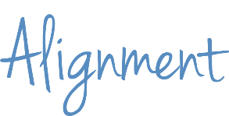
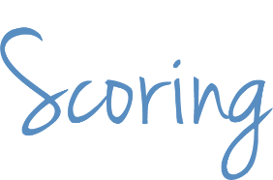
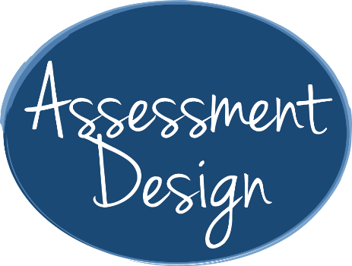
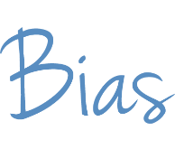
KEY CONCEPTS
Sources: To create this list, we synthesized information from several sources: Kansas State Department of Education, Assessment Literacy Project; Ohio Department of Education, “Assessment Literacy: Identifying and Developing Valid and Reliable Assessments” (2013); Relay Graduate School of Education, Designing and Evaluating Assessments (2014); Rhode Island Department of Education, “Deeping Assessment Literacy.”
Notes:
The five elements of assessment design that we discuss in these modules are alignment, rigor, precision, bias and scoring.

Slide 15
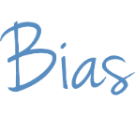
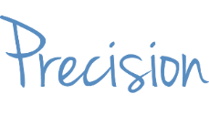
KEY CONCEPTS
An assessment that is ALIGNED WITH STANDARDS measures student performance against those standards
Notes:
An assessment that is aligned with standards measures student performance against those standards.

Slide 16
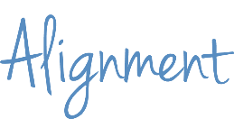
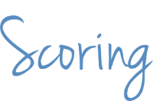
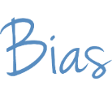
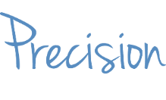
KEY CONCEPTS
An assessment has an APPROPRIATE LEVEL OF RIGOR if the assessment includes assessment items that match the level of rigor of the skill(s) you intend to measure and the assessment measures a range of student thinking and understanding so that it measures what all students know and can do
Notes:
An assessment has an appropriate level of rigor if the assessment includes assessment items that match the level of rigor of the skill or skills you intend to measure and the assessment measures a range of student thinking and understanding so that it measures what all students know and can do.

Slide 17
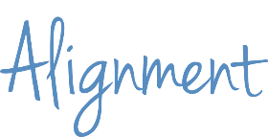
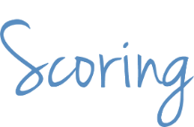
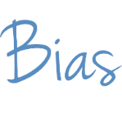
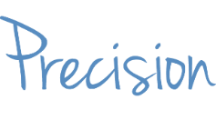
KEY CONCEPTS
A PRECISE assessment measures students’ knowledge and skills, not their misinterpretations or lack of unrelated background knowledge
Notes:
A precise assessment measures students’ knowledge and skills, not their misinterpretations or lack of unrelated background knowledge.

Slide 18
KEY CONCEPTS
An UNBIASED assessment measures students’ knowledge and skills, not differences among groups of students because of their personal characteristics, such as race, gender, socioeconomic status or religion
Notes:
An unbiased assessment measures students’ knowledge and skills, not differences among groups of students because of their personal characteristics, such as race, gender, socioeconomic status or religion.

Slide 19
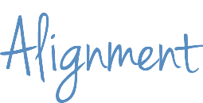
KEY CONCEPTS
An assessment that has an
APPROPRIATE SCORING STRATEGY measures students’ knowledge and skills, not how or when the assessment is scored or who scores it
Notes:
And an assessment that has an appropriate scoring strategy measures students’ knowledge and skills, not how or when the assessment is scored or who scores it. That is, if you have a strong rubric for a social studies essay and take the time to calibrate scores with others who will be grading the papers, it shouldn’t matter whether Ms. Smith the notoriously “easy grader” or “super-strict” Mr. Jones grades your students’ papers.

Slide 20
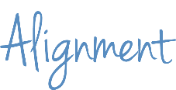
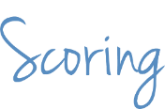
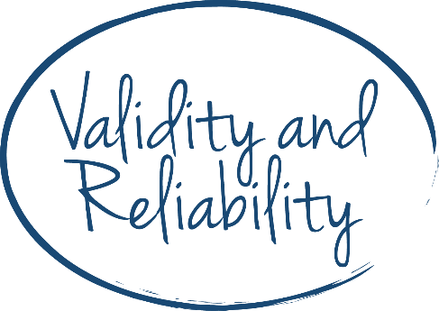
KEY CONCEPTS
Notes:
These five elements contribute to two overarching characteristics of a well-designed assessment: validity and reliability.

Slide 21
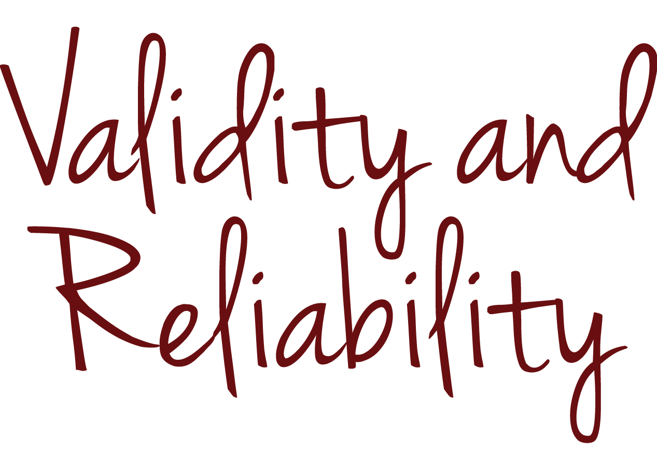
KEY CONCEPTS

Slide 22
KEY CONCEPTS
validity
the extent to which an assessment measures what you intend it to measure
reliability
the extent to which a student’s score will be the same no matter when, where or in what form the student takes the assessment or who scores it
Sources: Kansas State Department of Education, Assessment Literacy Project; Ohio Department of Education, “Assessment Literacy: Identifying and Developing Valid and Reliable Assessments” (2013).
Notes:
“Validity” and “reliability” are terms you’ve probably heard and used. Validity refers to the accuracy of an assessment—the extent to which it measures what you intend it to measure. For example, if you were to write a test question to measure your students’ ability to add fractions, you could unintentionally measure your students’ advanced reading ability if you use vocabulary that is well above grade level. Reliability refers to an assessment’s consistency—the extent to which a student’s score will be the same no matter when, where or in what form the student takes the assessment or who scores it—whether it’s you or the teacher down the hall.

Slide 23
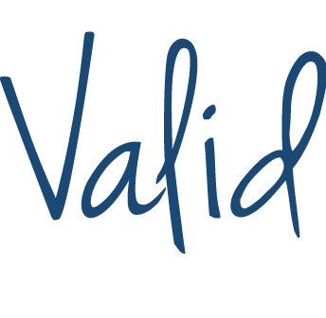
KEY CONCEPTS
Notes:
Validity and reliability are terms that researchers and test makers often use in association with precise statistical definitions and large-scale standardized tests, such as the SAT or assessments used for school accountability. The psychometric discipline of designing valid and reliable large-scale assessments is not easily replicated when educators are designing assessments for smaller scales of use, such as the classroom or school.

Slide 24
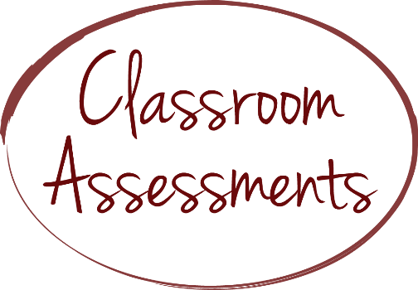
KEY CONCEPTS
Notes:
Assessments that you use in your classroom are smaller in scale and do not demand the same level of scrutiny, but you can consider the five elements of assessment design that we introduced earlier to ensure that your classroom assessments are as valid and reliable as possible. Once you master how to address these five elements, you will be able to plan, write and select assessments that have an appropriate level of validity and reliability for use in your classroom.

Slide 25
KEY CONCEPTS
Notes:
In other words, we recommend that you master the practical application of validity and reliability through mastery of these five pragmatic concepts, not the concepts you might address in a graduate-level statistics class.

Slide 26
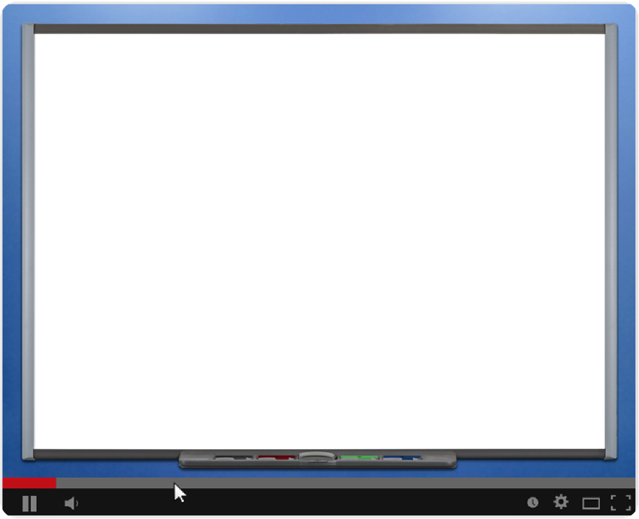
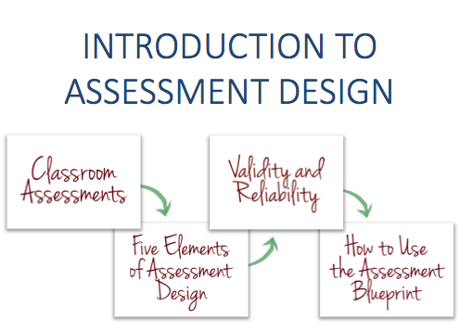
KEY CONCEPTS
Notes:
Before you continue, consider pausing the video to think about what you have learned or rewinding the video to revisit key concepts. If you’re viewing the video with colleagues, feel free to pause the video and discuss any questions that you may have.

Slide 27
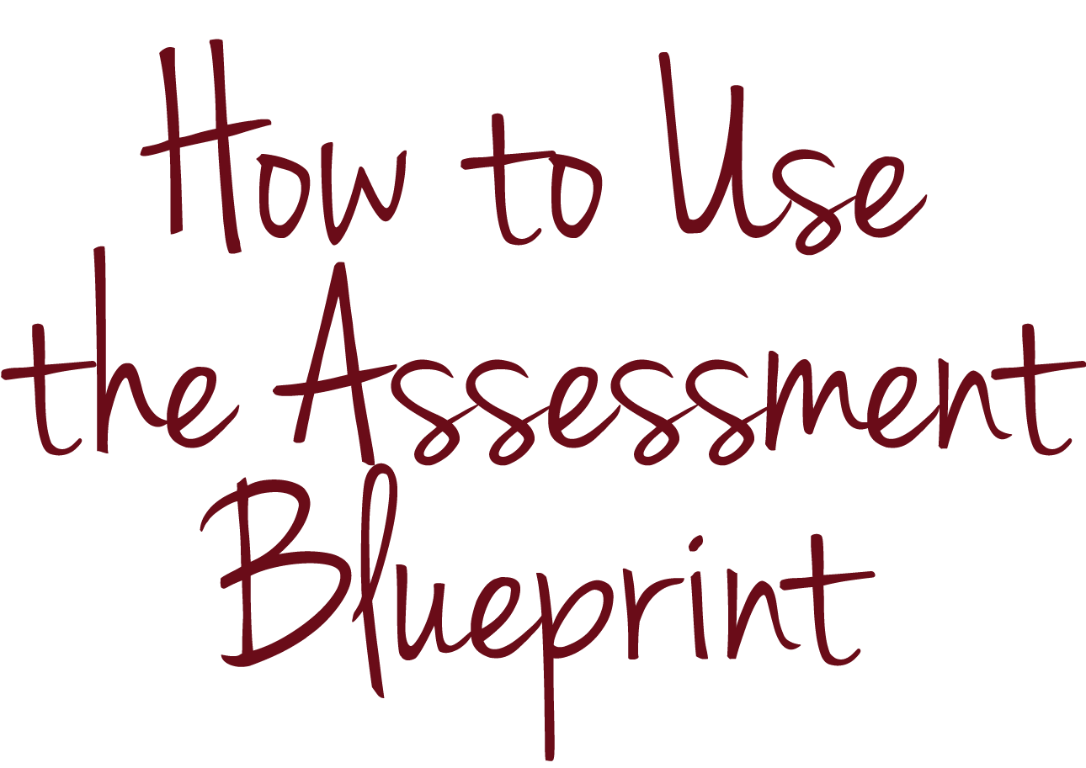
KEY CONCEPTS

Slide 28
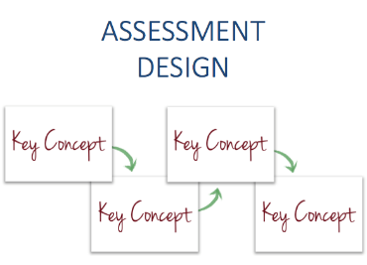
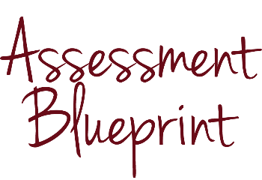
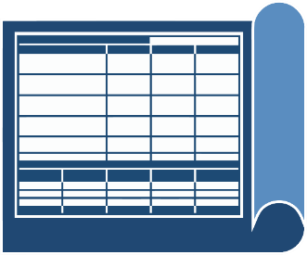
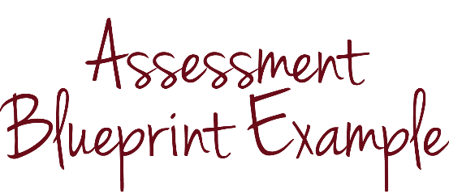
KEY CONCEPTS
Notes:
Throughout this series of modules, we use two tools—the assessment blueprint and assessment blueprint example—to help you organize the concepts.

Slide 29
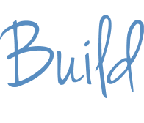
KEY CONCEPTS
Notes:
A “blueprint” is a detailed outline or plan of action. Architects use blueprints to ensure that their houses are well designed. They plan first and build second.

Slide 30
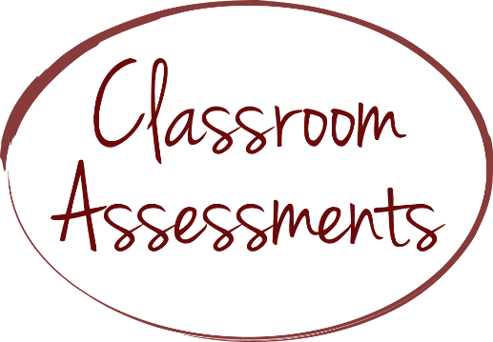
KEY CONCEPTS
Notes:
Like an architect, and as skillfully as an architect, you can use a blueprint to ensure that your assessments are well designed. In other words, you plan your assessment first and then write or select it.

Slide 31
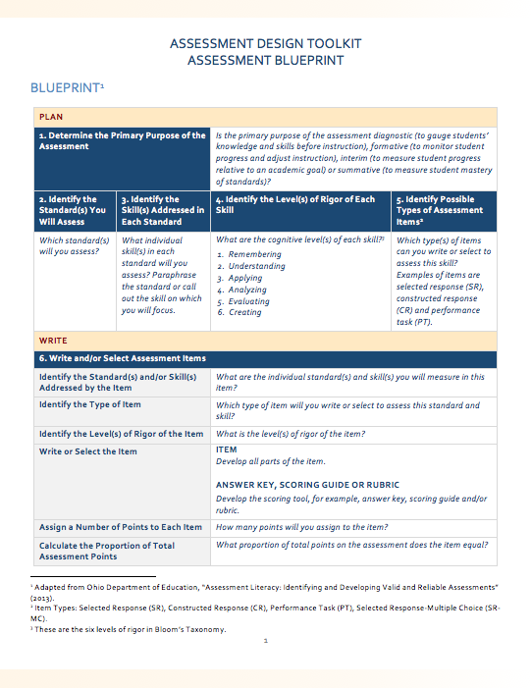
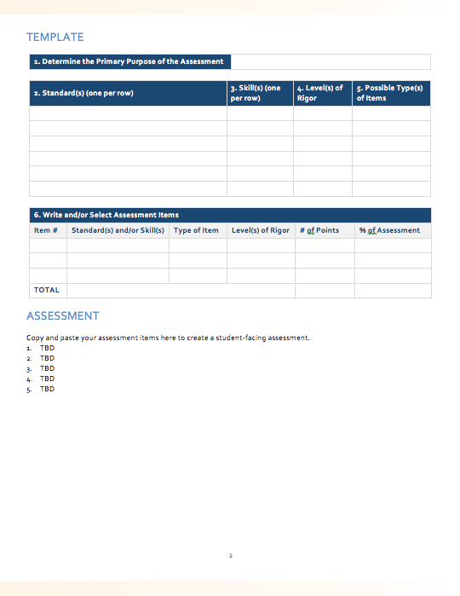
KEY CONCEPTS
Source: Adapted from Ohio Department of Education, “Assessment Literacy: Identifying and Developing Valid and Reliable Assessments” (2013).
Notes:
The assessment blueprint we use in this series of modules includes a table with directions and a blank template that you can repurpose to design your own assessments.

Slide 32
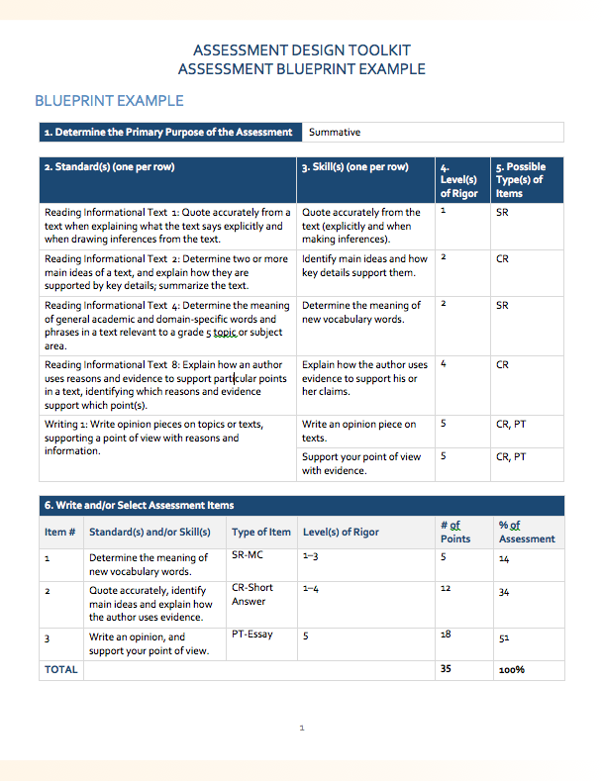
KEY CONCEPTS
1. Primary Purpose of the Assessment |  |  |  | Summative
2. Standard(s) (one per row) |  |  | 3. Skill(s) (one per row) | 4. Level(s) of Rigor | 5. Possible Type(s) of Items
Reading Informational Text 1: Quote accurately from a text when explaining what the text says explicitly and when drawing inferences from the text. |  |  | Quote accurately from the text (explicitly and making inferences). | 1 | SR
Reading Informational Text 2: Determine two or more main ideas of a text and explain how they are supported by key details; summarize the text. |  |  | Identify main ideas and how key details support them. | 2 | CR
Reading Informational Text 4: Determine the meaning of general academic and domain-specific words and phrases in a text relevant to a grade 5 topic or subject area. |  |  | Determine the meaning of new vocabulary words. | 2 | SR
Reading Informational Text 8: Explain how an author uses reasons and evidence to support particular points in a text, identifying which reasons and evidence support which point(s). |  |  | Explain how the author uses evidence to support his or her claims. | 4 | CR
Writing 1: Write opinion pieces on topics or texts, supporting a point of view with reasons and information. |  |  | Write an opinion piece on texts. | 5 | CR, PT
 |  |  | Support your point of view with evidence. | 5 | CR, PT
6. Write and/or Select Assessment Items
Item # | Standard(s) and/or Skill(s) | Type of Item | Level(s) of Rigor | # of Points | % of Assessment
1 | Determine the meaning of new vocabulary words. | SR-MC | 1–3 | 5 | 14
2 | Quote accurately, identify main ideas and explain how the author uses evidence. | CR-Short Answer | 1–4 | 12 | 34
3 | Write an opinion, and support your point of view. | PT-Essay | 5 | 18 | 51
TOTAL |  |  |  | 35 | 100%
Sources: Ohio Department of Education, “Ohio’s New Learning Standards: English Language Standards” (2010); Student Achievement Partners, “Mini-assessment for Who was Marco Polo? by Joan Holub and The Adventures of Marco Polo by Russell Freedman” (2014).
Notes:
The assessment blueprint example is the template filled out with an example.

Slide 33
KEY CONCEPTS
1. Primary Purpose of the Assessment
2. Standard(s) (one per row) |  |  | 3. Skill(s) (one per row) | 4. Level(s) of Rigor | 5. Possible Type(s) of Items
6. Write and/or Select Assessment Items
Item # | Standard(s) and/or Skill(s) | Type of Item | Level(s) of Rigor | # of Points | % of Assessment
TOTAL
Notes:
The assessment blueprint includes six steps:
Determine the primary purpose of the assessment.
Identify the standard or standards you will assess.
Identify the skill or skills addressed in each standard.
Identify the level or levels of rigor of each skill.
Identify possible types of assessment items and
Write and/or select assessment items.

Slide 34
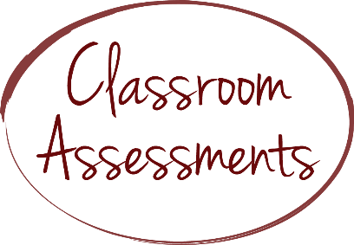
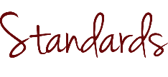
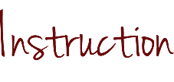
KEY CONCEPTS
Source: Moody, Michael, and Jason Stricker, Strategic Design for Student Achievement (2008).
Notes:
These steps show a process of backward design, in which you first determine which standard or standards you plan to measure; second, design your assessment to measure mastery of the standard or standards; and third, plan your instruction.

Slide 35
KEY CONCEPTS
1. Primary Purpose of the Assessment |  |  |  | Summative
2. Standard(s) (one per row) |  |  | 3. Skill(s) (one per row) | 4. Level(s) of Rigor | 5. Possible Type(s) of Items
Reading Informational Text 1: Quote accurately from a text when explaining what the text says explicitly and when drawing inferences from the text. |  |  | Quote accurately from the text (explicitly and making inferences). | 1 | SR
Reading Informational Text 2: Determine two or more main ideas of a text and explain how they are supported by key details; summarize the text. |  |  | Identify main ideas and how key details support them. | 2 | CR
Reading Informational Text 4: Determine the meaning of general academic and domain-specific words and phrases in a text relevant to a grade 5 topic or subject area. |  |  | Determine the meaning of new vocabulary words. | 2 | SR
Reading Informational Text 8: Explain how an author uses reasons and evidence to support particular points in a text, identifying which reasons and evidence support which point(s). |  |  | Explain how the author uses evidence to support his or her claims. | 4 | CR
Writing 1: Write opinion pieces on topics or texts, supporting a point of view with reasons and information. |  |  | Write an opinion piece on texts. | 5 | CR, PT
 |  |  | Support your point of view with evidence. | 5 | CR, PT
6. Write and/or Select Assessment Items
Item # | Standard(s) and/or Skill(s) | Type of Item | Level(s) of Rigor | # of Points | % of Assessment
1 | Determine the meaning of new vocabulary words. | SR-MC | 1–3 | 5 | 14
2 | Quote accurately, identify main ideas and explain how the author uses evidence. | CR-Short Answer | 1–4 | 12 | 34
3 | Write an opinion, and support your point of view. | PT-Essay | 5 | 18 | 51
TOTAL |  |  |  | 35 | 100%
Notes:
Throughout this series of modules, we will explain each of these steps and illustrate them with an example, which you can find in the assessment blueprint example.

Slide 36
KEY CONCEPTS
Notes:
Although we use the assessment blueprint to organize the concepts that we address in this series of modules, you may find it to be a useful tool for your practice on some occasions and not others. Use your professional judgment.

Slide 37
CHECK FOR UNDERSTANDING
Notes:
We have addressed the key concepts in this module, so let’s review our goals.

Slide 38
CHECK FOR UNDERSTANDING
Define FIVE ELEMENTS OF ASSESSMENT DESIGN AND VALIDITY AND RELIABILITY
Explain WHY teachers should focus on FIVE ELEMENTS OF ASSESSMENT DESIGN
Explain the purpose of the ASSESSMENT BLUEPRINT and the ASSESSMENT BLUEPRINT EXAMPLE
Notes:
At the outset of the module, we set goals that you would be able to define several key terms and concepts that are foundational to this series of modules—including what the modules identify as five elements of assessment design and validity and reliability—and explain why teachers should focus on these five elements of assessment design and not the statistical concepts associated with validity and reliability as researchers and test makers apply them. We also set a goal that you would be able to explain the purpose of two tools that that we reference throughout the modules: an assessment blueprint template and an assessment blueprint filled out with an example.

Slide 39
CHECK FOR UNDERSTANDING
Notes:
Although we cannot check to determine whether we have achieved all of these goals, let’s use two assessment items to check your understanding of two of them.

Slide 40
CHECK FOR UNDERSTANDING
Discuss in one to three sentences why we recommend that you focus on five elements of assessment design as opposed to the statistical concepts associated with validity and reliability.
Notes:
Here’s the first item:
Discuss in one to three sentences why we recommend that you focus on five elements of assessment design as opposed to the statistical concepts associated with validity and reliability.

Slide 41
CHECK FOR UNDERSTANDING
Discuss in one to three sentences why we recommend that you focus on five elements of assessment design as opposed to the statistical concepts associated with validity and reliability.
Notes:
Pause this video if you want a few moments to think about your answer or discuss it with colleagues.

Slide 42
CHECK FOR UNDERSTANDING
Discuss in one to three sentences why we recommend that you focus on five elements of assessment design as opposed to the statistical concepts associated with validity and reliability.
Assessments that I use in my classroom do not demand the same level of statistical scrutiny as large-scale, standardized tests, but I can consider five elements of assessment design to ensure that my assessments are reasonably valid and reliable. Once I master how to address these five elements, I will be able to plan, write and select assessments that have an appropriate level of validity and reliability for use in my classroom.
Notes:
A sample answer to the first item would be: Assessments that I use in my classroom do not demand the same level of statistical scrutiny as large-scale, standardized tests, but I can consider five elements of assessment design to ensure that my assessments are reasonably valid and reliable. Once I master how to address these five elements, I will be able to plan, write and select assessments that have an appropriate level of validity and reliability for use in my classroom.

Slide 43
CHECK FOR UNDERSTANDING
What are the assessment blueprint and assessment blueprint example, and how will you use them to understand the concepts in this series of modules and plan assessments in the future?
Notes:
Here’s the second item: What are the assessment blueprint and assessment blueprint example, and how will you use them to understand the concepts in this series of modules and plan assessments in the future?

Slide 44
CHECK FOR UNDERSTANDING
What are the assessment blueprint and assessment blueprint example, and how will you use them to understand the concepts in this series of modules and plan assessments in the future?
Notes:
Pause this video if you want a few moments to think about your answer or discuss it with colleagues.

Slide 45
CHECK FOR UNDERSTANDING
What are the assessment blueprint and assessment blueprint example, and how will you use them to understand the concepts in this series of modules and plan assessments in the future?
The assessment blueprint and the assessment blueprint example are tools to help me organize the concepts in this series of modules. The assessment blueprint includes a table with directions and a blank template that I can repurpose to design my own assessments. The assessment blueprint example is the template filled out with an example. I can use the tools in my teaching practice to help me determine which standard or standards I plan to measure and design assessments to measure mastery of the standard or standards before I begin teaching.
Notes:
A sample answer to the second item would be: The assessment blueprint and the assessment blueprint example are tools to help me organize the concepts in this series of modules. The assessment blueprint includes a table with directions and a blank template that I can repurpose to design my own assessments. The assessment blueprint example is the template filled out with an example. I can use the tools in my teaching practice to help me determine which standard or standards I plan to measure and design assessments to measure mastery of the standard or standards before I begin teaching.

Slide 46
CONCLUSION
Notes:
Good work! Thank you for completing the introductory module. Please view additional modules to continue your learning.

