Slide 1
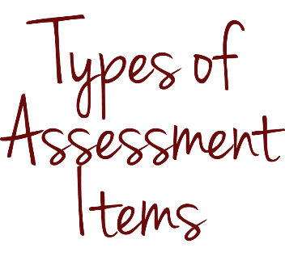
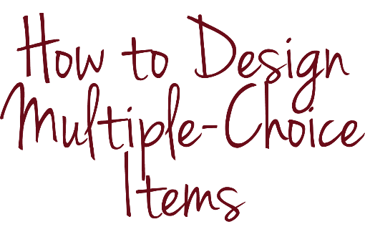
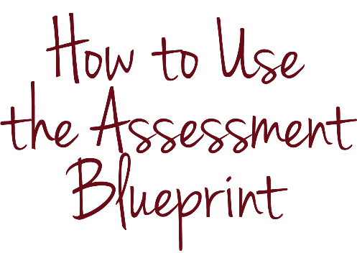
Selected-response
items

Slide 2
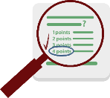
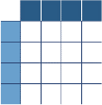
INTRODUCTION & OBJECTIVES
Students select a response
Students construct a response
Students create products or perform tasks to show their mastery of a particular skill
Notes:
The focus of this module is selected-response items, which, if done well, are a lot more difficult to design than your students probably realize.

Slide 3
INTRODUCTION & OBJECTIVES
Define what a SELECTED-RESPONSE item is
Identify the BENEFITS and CHALLENGES selected-response items present
Know the FOUR PARTS of a well-designed MULTIPLE-CHOICE item
Use the ASSESSMENT BLUEPRINT to help you design assessment items
Notes:
By the end of this module, you should be able to define what a selected-response item is, identify the benefits and challenges selected-response items present, know the four parts of a well-designed multiple-choice item and use the assessment blueprint to help you design assessment items.

Slide 4
KEY CONCEPTS
Notes:
Now, let’s get started with a quick review of the three types of assessment items.

Slide 5
KEY CONCEPTS
Notes:
We can categorize assessment items into three types: selected-response items, constructed-response items and performance tasks.

Slide 6
KEY CONCEPTS
Students construct a response
Sources: Kansas State Department of Education, Assessment Literacy Project; Ohio Department of Education, “How to Design and Select Quality Assessments;” Relay Graduate School of Education, Designing and Evaluating Assessments (2014); Rhode Island Department of Education, “Deepening Assessment Literacy.”
Notes:
Constructed-response items ask students to write, or “construct,” the correct answer.

Slide 7
KEY CONCEPTS
Students create products or perform tasks to show their mastery of a particular skill
Sources: Kansas State Department of Education, Assessment Literacy Project; Ohio Department of Education, “How to Design and Select Quality Assessments;” Relay Graduate School of Education, Designing and Evaluating Assessments (2014); Rhode Island Department of Education, “Deepening Assessment Literacy.”
Notes:
Performance tasks ask students to create products or perform tasks to show their mastery of particular skills.

Slide 8
KEY CONCEPTS

Slide 9
KEY CONCEPTS
Students select a response
Sources: Kansas State Department of Education, Assessment Literacy Project; Ohio Department of Education, “How to Design and Select Quality Assessments;” Relay Graduate School of Education, Designing and Evaluating Assessments (2014); Rhode Island Department of Education, “Deepening Assessment Literacy.”
Notes:
Selected-response items are the focus of this module. They ask students to select the correct answer from a list of options included in the item. Examples of selected-response items include matching, true/false and multiple choice. We use answer keys and scoring guides to score these items.

Slide 10
KEY CONCEPTS
Selected-response items are efficient
You can use selected-response items to assess a range of student knowledge and skills
You can score selected-response items faster than other types of items
Notes:
These items offer a major advantage: They are efficient. You can use selected-response items to assess a range of student knowledge and skills, and you can score them faster than other types of assessment items.

Slide 11
KEY CONCEPTS
Selected-response items cannot directly measure higher-order thinking in the same way that, for example, an essay prompt can
Students can guess the answers to selected-response items, which makes the results less accurate
A long assessment that contains only selected-response items can overwhelm and frustrate students
Notes:
Although well-designed selected-response items can measure higher-order thinking, they cannot do so in the same direct manner as constructed-response items and performance tasks. This is because students are always selecting the answer, not creating it themselves. Students can also guess the answers to selected-response items, which makes the results less accurate. Finally, a long assessment that contains only selected-response items can overwhelm and frustrate students.

Slide 12
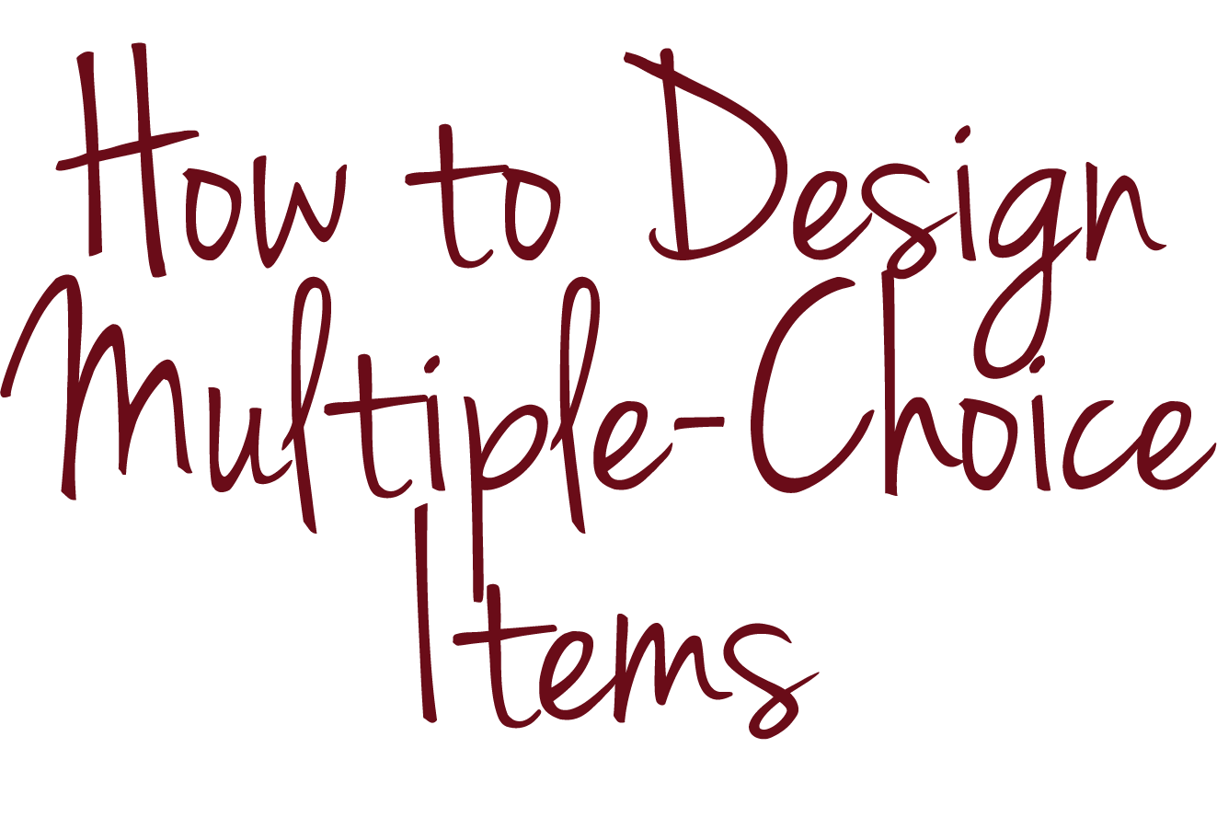
KEY CONCEPTS

Slide 13
KEY CONCEPTS
Students select a response
Notes:
We will now describe in detail how to design a common type of selected-response item—multiple choice.

Slide 14
KEY CONCEPTS
Notes:
Multiple-choice items require students to choose the correct answer from four or five possibilities.

Slide 15
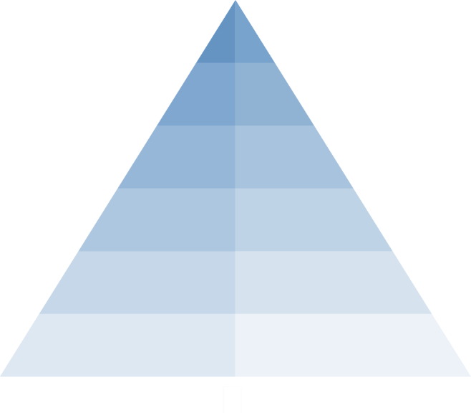
KEY CONCEPTS
Notes:
They are useful because they can measure a range of student knowledge and skills, but they do not require you to use a scoring guide or rubric. (Although, as the module about scoring suggests, you can add rationales to answer keys to inform your instruction.)

Slide 16
KEY CONCEPTS
Notes:
We can also apply these steps to write and select matching and true/false items.

Slide 17
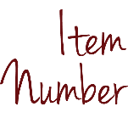
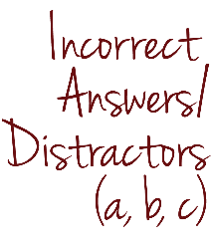
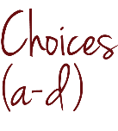
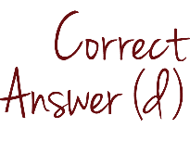
KEY CONCEPTS
The shapes shown are part of a design.
What do all of these shapes appear to have in common?
All have four right angles.
All have four equal sides.
All have at least one set of perpendicular lines.
All have at least one set of parallel sides.
Source: Relay Graduate School of Education, Rules for Multiple Choice Item Design (2013).
Notes:
A typical multiple-choice item contains four parts: an item number, background information, a prompt and choices. The choices include one correct answer and several incorrect answers, which are also known as distractors. Let’s use examples to describe how you can develop each of these parts so that the item, as a whole, is well designed.

Slide 18
KEY CONCEPTS
The shapes shown are part of a design.
What do all of these shapes appear to have in common?
All have four right angles.
All have four equal sides.
All have at least one set of perpendicular lines.
All have at least one set of parallel sides.
Source: Relay Graduate School of Education, Rules for Multiple Choice Item Design (2013).
Notes:
An item number orients students to where the item fits within the assessment.

Slide 19
KEY CONCEPTS
item number
part of a multiple-choice assessment item that orients students to where the item fits within the assessment
Number each item
Source: Relay Graduate School of Education, Rules for Multiple Choice Item Design (2013).
Notes:
The best practice for this part is self-explanatory: You should number each item.

Slide 20
KEY CONCEPTS
The shapes shown are part of a design.
What do all of these shapes appear to have in common?
All have four right angles.
All have four equal sides.
All have at least one set of perpendicular lines.
All have at least one set of parallel sides.
Source: Relay Graduate School of Education, Rules for Multiple Choice Item Design (2013).
Notes:
Background information includes what students need to know to select the correct answer.

Slide 21
KEY CONCEPTS
background information
part of a multiple-choice assessment item that includes what students need in order to select the correct answer
Include all necessary information students need in order to to select the correct answer
Source: Relay Graduate School of Education, Rules for Multiple Choice Item Design (2013).
Notes:
Be sure to include all necessary information that students need in order to select the correct answer.

Slide 22
KEY CONCEPTS
Choose the one answer that best solves the problem.
If one card is taken at random from a deck of playing cards, what is the probability that the card will be an ace?
8 percent
50 percent
25 percent
10 percent
Source: New Jersey Department of Education, SGO 2.0—From Compliance to Quality (2014).
Notes:
What background information is missing in this item? You may remember this assessment item from a different module.
Choose the one answer that best solves the problem.
If one card is taken at random from a deck of playing cards, what is the probability that the card will be an ace?
8 percent;
50 percent;
25 percent; or
10 percent

Slide 23
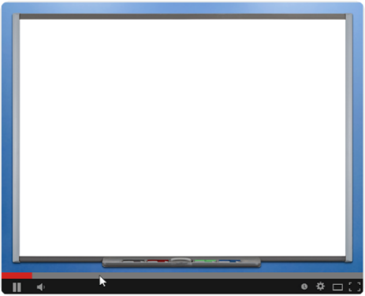
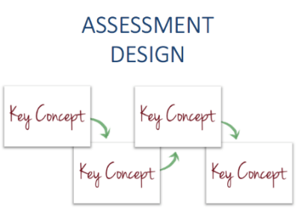
KEY CONCEPTS
Choose the one answer that best solves the problem.
If one card is taken at random from a deck of playing cards, what is the probability that the card will be an ace?
8 percent
50 percent
25 percent
10 percent
Notes:
Pause this video if you want a few moments to think about your answer or discuss it with colleagues.

Slide 24
KEY CONCEPTS
Directions: Choose the one answer that best solves the problem.
There are 4 aces in a deck of 52 playing cards. If one card is taken at random from a deck of playing cards, what is the probability that the card will be an ace?
8 percent
50 percent
25 percent
10 percent
Notes:
The item omits two key pieces of information that students need to know in order to select the correct answer: the number of aces and the total number of cards in a deck of cards. We can make the item clearer if we add into the item the missing facts—“there are 4 aces in a deck of 52 playing cards.”

Slide 25
KEY CONCEPTS
The shapes shown are part of a design.
What do all of these shapes appear to have in common?
All have four right angles.
All have four equal sides.
All have at least one set of perpendicular lines.
All have at least one set of parallel sides.
Source: Relay Graduate School of Education, Rules for Multiple Choice Item Design (2013).
Notes:
The prompt asks a question or describes a task.

Slide 26
KEY CONCEPTS
prompt
part of a multiple-choice assessment item that asks a question or describes a task
Frame prompts positively or emphasize negative key words
Source: Relay Graduate School of Education, Rules for Multiple Choice Item Design (2013).
Notes:
You should try to frame prompts positively. Just because a student can recognize an incorrect answer does not mean that he or she knows the correct answer. If you decide to use a negative prompt, be sure to emphasize the negative key words so that students are not confused.

Slide 27
KEY CONCEPTS
A student is revising this paragraph and needs to take out information that does not support why birds make good pets.
There are many reasons why people keep birds as pets. Canaries sing beautiful songs. Parakeets will sit on your shoulder. Parrots can talk to you. Birds fly outdoors. Pet birds can be fun.
Which of the following sentences does not support why birds make good pets?
“Canaries sing beautiful songs.”
“Parakeets will sit on your shoulder.”
“Parrots can talk to you.”
“Birds fly outdoors.”
Source: Haywood County Schools, “Smarter Balanced Test Items Samples: ELA Grade 3.”
Notes:
For example, this item has a negative prompt.
A student is revising the following paragraph and needs to take out information that does not support why birds make good pets.
There are many reasons why people keep birds as pets. Canaries sing beautiful songs. Parakeets will sit on your shoulder. Parrots can talk to you. Birds fly outdoors. Pet birds can be fun.
Which of the following sentences does not support why birds make good pets?
“Canaries sing beautiful songs.”
“Parakeets will sit on your shoulder.”
“Parrots can talk to you.”
“Birds fly outdoors.”
How might you revise the item to emphasize the negative word?

Slide 28
KEY CONCEPTS
A student is revising this paragraph and needs to take out information that does NOT support why birds make good pets.
There are many reasons why people keep birds as pets. Canaries sing beautiful songs. Parakeets will sit on your shoulder. Parrots can talk to you. Birds fly outdoors. Pet birds can be fun.
Which of the following sentences does not support why birds make good pets?
“Canaries sing beautiful songs.”
“Parakeets will sit on your shoulder.”
“Parrots can talk to you.”
“Birds fly outdoors.”
Notes:
You can capitalize and underline the word “not” in the prompt to make clear what students need to do.

Slide 29
KEY CONCEPTS
prompt
part of a multiple-choice assessment item that asks a question or describes a task
Frame prompts positively or emphasize negative key words
Ensure that prompts do not require that students know information not included in the prompt
Source: Relay Graduate School of Education, Rules for Multiple Choice Item Design (2013).
Notes:
A prompt should not require students to know information not included in the prompt.

Slide 30
KEY CONCEPTS
The word “attribute” means:
to regard something as being caused by someone or something
a quality or feature regarded as a characteristic or inherent part of someone or something
to give someone a gift
blame
Notes:
What clarification would students need to answer this item, and how might you rewrite the prompt to eliminate the need for the clarification?
The word “attribute” means:
to regard something as being caused by someone or something.;
a quality or feature regarded as a characteristic or inherent part of someone or something;
to give someone a gift; or
blame.

Slide 31
KEY CONCEPTS
The word “attribute” means:
to regard something as being caused by someone or something
a quality or feature regarded as a characteristic or inherent part of someone or something
to give someone a gift
blame
Marlena said in her victory speech that she must attribute her success to her supportive parents and teachers. In this context, the word “attribute” means ___________.
Notes:
The item requires students to know in what context the speaker or writer is using the word “attribute,” but the prompt does not contain the appropriate context. The revised prompt provides the appropriate context by using the word in a sentence.
Marlena said in her victory speech that she must attribute her success to her supportive parents and teachers. In this context, the word “attribute” means BLANK.

Slide 32
KEY CONCEPTS
prompt
part of a multiple-choice assessment item that asks a question or describes a task
Frame prompts positively or emphasize negative key words
Ensure that prompts do not require that students know information not included in the prompt
Do not include words or grammatical cues that might give away the answer
Source: Relay Graduate School of Education, Rules for Multiple Choice Item Design (2013).
Notes:
Prompts should not include words or grammatical cues that might give away the answer.

Slide 33
KEY CONCEPTS
A frog is an example of an:
mammal
amphibian
reptile
fish
Notes:
What in this prompt gives away the answer?
A frog is an example of an:
mammal;
amphibian;
reptile; or
fish.

Slide 34
KEY CONCEPTS
A frog is an example of an:
mammal
amphibian
reptile
fish
Frogs belong to which class of animals?
Notes:
Because “amphibian” is the only choice that begins with a vowel and requires “an” as an article instead of “a,” students could infer that “amphibian” is the correct answer without knowing that a frog is an example of an amphibian. We can revise the item by rephrasing the prompt. For example:
Frogs belong to which class of animals?

Slide 35
KEY CONCEPTS
prompt
part of a multiple-choice assessment item that asks a question or describes a task
Frame prompts positively or emphasize negative key words
Ensure that prompts do not require that students know information not included in the prompt
Do not include words or grammatical cues that might give away the answer
Include words in the prompt that would otherwise be repeated in choices
Source: Relay Graduate School of Education, Rules for Multiple Choice Item Design (2013).
Notes:
Items should be as concise as possible, which often requires a concise prompt. To simplify prompts, you can include words in the prompt that would otherwise be repeated in choices.

Slide 36
KEY CONCEPTS
The three parts of the Constitution include:
the Preamble, the Articles and the Bylaws
the Preamble, the Articles and the three branches of government
the Preamble, the Articles and the Articles of Confederation
the Preamble, the Articles and the Amendments
Notes:
How could we simplify the prompt in the assessment item?
The three parts of the Constitution include:
the Preamble, the Articles and the Bylaws;
the Preamble, the Articles and the three branches of government;
the Preamble, the Articles and the Articles of Confederation; or
the Preamble, the Articles and the Amendments

Slide 37
KEY CONCEPTS
The three parts of the Constitution include the Preamble, the Articles and the:
Bylaws
three branches of government
Articles of Confederation
Amendments
Notes:
We can include two parts of the Constitution in every choice: “the Preamble” and “the Articles.” For example:
The three parts of the Constitution include the Preamble, the Articles and the:
Bylaws;
three branches of government;
Articles of Confederation; or
Amendments

Slide 38
KEY CONCEPTS
The shapes shown are part of a design.
What do all of these shapes appear to have in common?
All have four right angles.
All have four equal sides.
All have at least one set of perpendicular lines.
All have at least one set of parallel sides.
Source: Relay Graduate School of Education, Rules for Multiple Choice Item Design (2013).
Notes:
Choices include answers to the item prompt.

Slide 39
KEY CONCEPTS
choices
part of a multiple-choice assessment item that include answers to the item prompt
Use the same number of choices on a single assessment
Option a: __________________________________________
Option b: __________________________________________
Option c: __________________________________________
Option d: __________________________________________
Source: Relay Graduate School of Education, Rules for Multiple Choice Item Design (2013).
Notes:
Multiple-choice items on a single assessment should always use the same number of choices so that students have the same odds of guessing the correct answer. We use four or five choices for most grades, though we can use as few as three choices for kindergarten and first grade. Four or five choices provide only a 20 or 25 percent chance of students guessing the correct answer and limits the number of good distractors you need to write.

Slide 40
KEY CONCEPTS
choices
part of a multiple-choice assessment item that include answers to the item prompt
Use the same number of choices on a single assessment
Use choices that are consistent in form, content and length
Source: Relay Graduate School of Education, Rules for Multiple Choice Item Design (2013).
Notes:
Choices should be consistent in form, content and length. Choices that are inconsistent with others stand out. For example, a choice draws attention if it is significantly longer or shorter than the other choices.

Slide 41
KEY CONCEPTS
What role did many colonial women play during the American Revolution?
They served as officers in the army.
They gave speeches to rally the people.
They kept the farms and shops running during the war, which was vital for the American economy.
They helped run the government.
Source: National Center on Education Statistics, NAEP Questions Tool “What role did many colonial women play during the American Revolution?”
Notes:
How can we revise the assessment item so that choice “c” does not stand out?
What role did many colonial women play during the American Revolution?
They served as officers in the army;
They gave speeches to rally the people;
They kept the farms and shops running during the war, which was vital for the American economy; or
They helped run the government.

Slide 42
KEY CONCEPTS
What role did many colonial women play during the American Revolution?
They served as officers in the army.
They gave speeches to rally the people against the British.
They kept the farms and shops running during the war.
They helped to run the government while the men were away fighting.
Notes:
We could shorten choice “c” and lengthen choices “b” and “d” so that the correct answer does not stand out.

Slide 43
KEY CONCEPTS
choices
part of a multiple-choice assessment item that include answers to the item prompt
Use the same number of choices on a single assessment
Use choices that are consistent in form, content and length
Order choices in a logical sequence
Source: Relay Graduate School of Education, Rules for Multiple Choice Item Design (2013).
Notes:
Choices should be ordered in a logical sequence because logical order enhances the perception of randomness.

Slide 44
KEY CONCEPTS
There are 30 students in a class. The ratio of boys to girls in the class is 2:3. How many boys are there in the class?
18
12
6
20
There are 30 students in a class. The ratio of boys to girls in the class is 2:3. How many boys are there in the class?
6
12
18
20
Sources: Relay Graduate School of Education, Rules for Multiple Choice Item Design (2013); International Association for the Evaluation of Educational Achievement, TIMSS 2007 User Guide for the International Database, Released Items Science—Fourth Grade (2009).
Notes:
For example, if the choices are numbers, order them from least to greatest or from greatest to least.

Slide 45
KEY CONCEPTS
Where do plants get energy from to make food?
sunlight
air
water
soil
Where do plants get energy from to make food?
air
soil
sunlight
water
Sources: Relay Graduate School of Education, Rules for Multiple Choice Item Design (2013); International Association for the Evaluation of Educational Achievement, TIMSS 2007 User Guide for the International Database, Released Items Science—Fourth Grade (2009).
Notes:
If the choices are single words, order them alphabetically.

Slide 46
KEY CONCEPTS
choices
part of a multiple-choice assessment item that include answers to the item prompt
Use the same number of choices on a single assessment
Use choices that are consistent in form, content and length
Order choices in a logical sequence
Include only one clearly correct answer, but make sure that your incorrect answers, “distractors,” are plausible
Source: Relay Graduate School of Education, Rules for Multiple Choice Item Design (2013).
Notes:
Include only one clearly correct answer, but make sure that your incorrect answers, also known as distractors, are plausible. If distractors are too obvious, students may be able to guess the correct answer, whether or not they have mastered the content. Strong distractors should reflect common student misconceptions and errors so that if students answer items incorrectly, you can gain information about where and how student understanding breaks down.

Slide 47
KEY CONCEPTS
A hungry wolf spied a goat at the top of a steep cliff where he could not possibly get at her. "That is a very dangerous place for you," he called out, pretending to be very anxious about the goat's safety. "What if you should fall? Please listen to me and come down! Here you can get all you want of the finest grass in the country." The goat looked over the edge of the cliff. "How very, very anxious you are about me," she said, "and how kind you are with your grass! But I know you! It's your own food you are thinking of, not mine!"
What does the word “anxious” mean in the text?
selfish
hungry
hopeful
worried
Source: Haywood County Schools, “Smarter Balanced Test Items Samples: ELA Grade 3.”
Notes:
Let’s consider an example:
The Wolf and the Goat
A hungry wolf spied a goat at the top of a steep cliff where he could not possibly get at her. “That is a very dangerous place for you,” he called out, pretending to be very anxious about the goat's safety. “What if you should fall? Please listen to me and come down! Here you can get all you want of the finest grass in the country.” The goat looked over the edge of the cliff. “How very, very anxious you are about me,” she said, “and how kind you are with your grass! But I know you! It’s your own food you are thinking of, not mine!”
What does the word “anxious” mean in the text?
selfish;
hungry;
hopeful; or
worried
How might you improve the distractors in this item?

Slide 48
KEY CONCEPTS
A hungry wolf spied a goat at the top of a steep cliff where he could not possibly get at her. "That is a very dangerous place for you," he called out, pretending to be very anxious about the goat's safety. "What if you should fall? Please listen to me and come down! Here you can get all you want of the finest grass in the country." The goat looked over the edge of the cliff. "How very, very anxious you are about me," she said, "and how kind you are with your grass! But I know you! It's your own food you are thinking of, not mine!"
What does the word “anxious” mean in the text?
selfish
hungry
hopeful
worried
Notes:
In this example, although there is one correct answer, all of the distractors are somewhat plausible. For example, “selfish” is plausible because the wolf in the text is selfishly trying to get the goat. “Hungry” is plausible because the wolf in the text wants to eat the goat. “Hopeful” is plausible because the wolf in the text is hopeful that he will get the goat. “Worried” is plausible and is the correct answer because it has the same meaning as “anxious.”

Slide 49
KEY CONCEPTS
choices
part of a multiple-choice assessment item that include answers to the item prompt
Use the same number of choices on a single assessment
Use choices that are consistent in form, content and length
Order choices in a logical sequence
Include only one clearly correct answer, but make sure that your incorrect answers, “distractors,” are plausible
Avoid using “all of the above” or “none of the above”
Source: Relay Graduate School of Education, Rules for Multiple Choice Item Design (2013).
Notes:
Finally, avoid using “all of the above” or “none of the above.” Items with these two choices stand out and may appeal to students who can answer an item with four choices correctly if they know that two of the choices are right, although they may not have known that the third choice is right.

Slide 50
KEY CONCEPTS
Assessment Item #
ITEM
ANSWER KEY, SCORING GUIDE OR RUBRIC
Notes:
Ideally, you will develop a well-designed scoring tool while you are developing each assessment item.

Slide 51
KEY CONCEPTS
Students select a response
Notes:
We typically use answer keys to score multiple-choice items.

Slide 52
KEY CONCEPTS
answer keys
scoring tools that provide the correct answer to an assessment item
Option a: __________________________________________
Option b: __________________________________________
Option c: __________________________________________
Option d: __________________________________________
Notes:
Answer keys provide the correct answer to an assessment item. Some well-designed answer keys explain why each choice is correct or incorrect, which can help you diagnose common student errors, adjust your instructional strategies and plan areas for re-teaching. The module about scoring includes more information about well-designed answer keys.

Slide 53
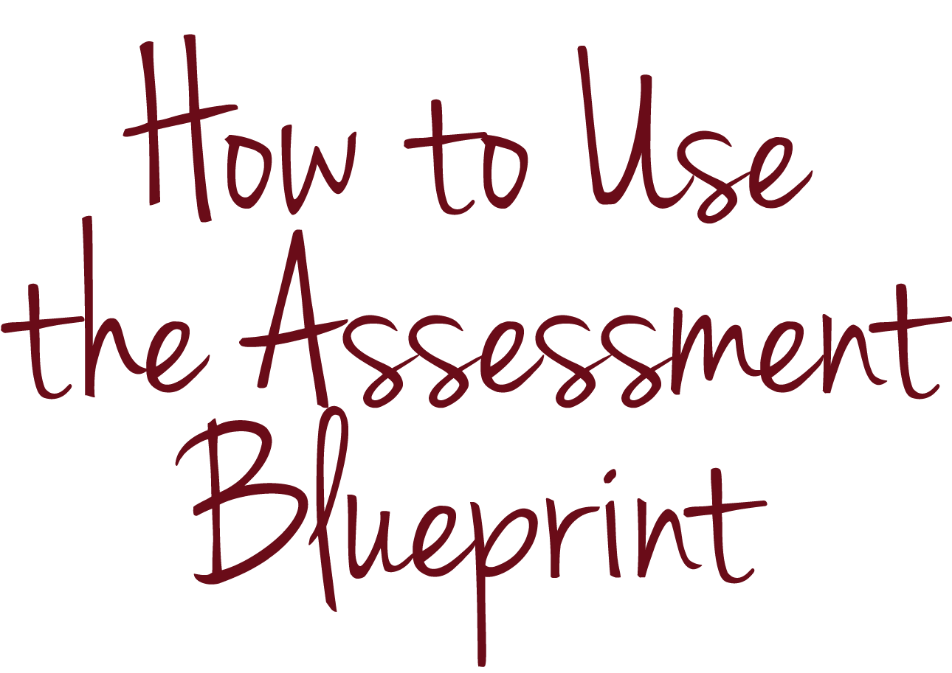
KEY CONCEPTS
Notes:
Let’s use the assessment blueprint and assessment blueprint example to apply what we’ve learned.

Slide 54
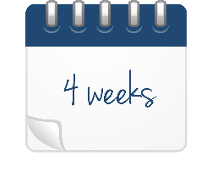
KEY CONCEPTS
Sources: Ohio Department of Education, “Ohio’s New Learning Standards: English Language Standards” (2010); Student Achievement Partners, “Mini-Assessment for Who Was Marco Polo? by Joan Holub and The Adventures of Marco Polo by Russell Freedman” (2014).
Notes:
Imagine that you are a fifth-grade teacher planning a unit focused on reading and writing about informational texts. You expect the unit to last approximately four weeks.

Slide 55
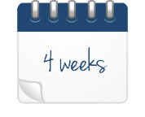
KEY CONCEPTS
Notes:
At the end of the unit, you plan to use a summative assessment to measure how well your students have mastered the relevant standards.

Slide 56
KEY CONCEPTS
1. Primary Purpose of the Assessment |  |  |  | Summative
2. Standard(s) (one per row) |  |  | 3. Skill(s) (one per row) | 4. Level(s) of Rigor | 5. Possible Type(s) of Items
Reading Informational Text 1: Quote accurately from a text when explaining what the text says explicitly and when drawing inferences from the text. |  |  | Quote accurately from the text (explicitly and making inferences). | 1 | SR
Reading Informational Text 2: Determine two or more main ideas of a text and explain how they are supported by key details; summarize the text. |  |  | Identify main ideas and how key details support them. | 2 | CR
Reading Informational Text 4: Determine the meaning of general academic and domain-specific words and phrases in a text relevant to a grade 5 topic or subject area. |  |  | Determine the meaning of new vocabulary words. | 2 | SR
Reading Informational Text 8: Explain how an author uses reasons and evidence to support particular points in a text, identifying which reasons and evidence support which point(s). |  |  | Explain how the author uses evidence to support his or her claims. | 4 | CR
Writing 1: Write opinion pieces on topics or texts, supporting a point of view with reasons and information. |  |  | Write an opinion piece on texts. | 5 | CR, PT
 |  |  | Support your point of view with evidence. | 5 | CR, PT
6. Write and/or Select Assessment Items
Item # | Standard(s) and/or Skill(s) | Type of Item | Level(s) of Rigor | # of Points | % of Assessment
TOTAL
Notes:
You have determined that the unit will focus on four reading informational text standards and one writing standard. You have “unpacked” the standards to identify and paraphrase the skills you plan to teach and assess. You have also identified a level of rigor for each item and possible types of items you may use to assess each skill.

Slide 57
KEY CONCEPTS
1. Primary Purpose of the Assessment |  |  |  | Summative
2. Standard(s) (one per row) |  |  | 3. Skill(s) (one per row) | 4. Level(s) of Rigor | 5. Possible Type(s) of Items
Reading Informational Text 1: Quote accurately from a text when explaining what the text says explicitly and when drawing inferences from the text. |  |  | Quote accurately from the text (explicitly and making inferences). | 1 | SR
Reading Informational Text 2: Determine two or more main ideas of a text and explain how they are supported by key details; summarize the text. |  |  | Identify main ideas and how key details support them. | 2 | CR
Reading Informational Text 4: Determine the meaning of general academic and domain-specific words and phrases in a text relevant to a grade 5 topic or subject area. |  |  | Determine the meaning of new vocabulary words. | 2 | SR
Reading Informational Text 8: Explain how an author uses reasons and evidence to support particular points in a text, identifying which reasons and evidence support which point(s). |  |  | Explain how the author uses evidence to support his or her claims. | 4 | CR
Writing 1: Write opinion pieces on topics or texts, supporting a point of view with reasons and information. |  |  | Write an opinion piece on texts. | 5 | CR, PT
 |  |  | Support your point of view with evidence. | 5 | CR, PT
6. Write and/or Select Assessment Items
Item # | Standard(s) and/or Skill(s) | Type of Item | Level(s) of Rigor | # of Points | % of Assessment
TOTAL
Notes:
Step 6 of the assessment blueprint asks you to write and/or select assessment items.

Slide 58
KEY CONCEPTS
6. Write and/or Select Assessment Items
Item # | Standard(s) and/or Skill(s) | Type of Item | Level(s) of Rigor | # of Points | % of Assessment
TOTAL
Assessment Item #
ITEM
ANSWER KEY, SCORING GUIDE OR RUBRIC
Notes:
For each item, it asks you to:
identify the standards and/or skills addressed by the item;
identify the type of item;
identify the level or levels of rigor of the item;
write or select the item; and
assign a number of points to the item.

Slide 59
KEY CONCEPTS
1. Primary Purpose of the Assessment |  |  |  | Summative
2. Standard(s) (one per row) |  |  | 3. Skill(s) (one per row) | 4. Level(s) of Rigor | 5. Possible Type(s) of Items
Reading Informational Text 1: Quote accurately from a text when explaining what the text says explicitly and when drawing inferences from the text. |  |  | Quote accurately from the text (explicitly and making inferences). | 1 | SR
Reading Informational Text 2: Determine two or more main ideas of a text and explain how they are supported by key details; summarize the text. |  |  | Identify main ideas and how key details support them. | 2 | CR
Reading Informational Text 4: Determine the meaning of general academic and domain-specific words and phrases in a text relevant to a grade 5 topic or subject area. |  |  | Determine the meaning of new vocabulary words. | 2 | SR
Reading Informational Text 8: Explain how an author uses reasons and evidence to support particular points in a text, identifying which reasons and evidence support which point(s). |  |  | Explain how the author uses evidence to support his or her claims. | 4 | CR
Writing 1: Write opinion pieces on topics or texts, supporting a point of view with reasons and information. |  |  | Write an opinion piece on texts. | 5 | CR, PT
 |  |  | Support your point of view with evidence. | 5 | CR, PT
6. Write and/or Select Assessment Items
Item # | Standard(s) and/or Skill(s) | Type of Item | Level(s) of Rigor | # of Points | % of Assessment
1 | Determine the meaning of new vocabulary words.
TOTAL
Notes:
For example, let’s say that you want to address with your first assessment item a skill associated with reading informational text standard 4: Determine the meaning of new vocabulary words.

Slide 60
KEY CONCEPTS
6. Write and/or Select Assessment Items
Item # | Standard(s) and/or Skill(s) | Type of Item | Level(s) of Rigor | # of Points | % of Assessment
1 | Determine the meaning of new vocabulary words. | SR-MC | 1–3 | 5
TOTAL
Notes:
You decide to write a multiple-choice item that requires lower-level thinking and is worth five points.

Slide 61
KEY CONCEPTS
Assessment Item #1
ITEM
ANSWER KEY, SCORING GUIDE OR RUBRIC
Notes:
The next step is to write the actual item, which includes developing all parts of the item and a scoring tool.

Slide 62
KEY CONCEPTS
Assessment Item #1
ITEM
In paragraph 4 of Who Was Marco Polo? the author states that an exaggeration became known as a “Marco Polo.” What is the meaning of the word “exaggeration”?
The choices are:
a misunderstanding of factual information
a long journey taken over several years
an individual who does exciting and interesting things
a statement that things are bigger or better than they are
Sources: Student Achievement Partners, “Mini-Assessment for Who Was Marco Polo? by Joan Holub and The Adventures of Marco Polo by Russell Freedman” (2014).
Notes:
Here’s an item from the assessment blueprint example:
In paragraph 4 of Who Was Marco Polo?, the author states that an exaggeration became known as a “Marco Polo.” What is the meaning of the word “exaggeration”?
The choices are:
a misunderstanding of factual information;
a long journey taken over several years;
an individual who does exciting and interesting things; or
a statement that things are bigger or better than they are.

Slide 63
KEY CONCEPTS
Assessment Item #1
ITEM
In paragraph 4 of Who Was Marco Polo? the author states that an exaggeration became known as a “Marco Polo.” What is the meaning of the word “exaggeration”?
The choices are:
a misunderstanding of factual information
a long journey taken over several years
an individual who does exciting and interesting things
a statement that things are bigger or better than they are
ANSWER KEY
Option a, “a misunderstanding of factual information,” implies that the reader has some confusion, but an exaggeration is an act on the part of the speaker/writer that shows the speaker/writer is deliberately not telling the whole truth.
Option b, “a long journey taken over several years,” describes Polo’s trip rather than his possible stretching of the truth.
Option c, “an individual who does exciting and interesting things,” describes Polo’s life rather than the possibility he didn’t tell the truth.
Option d is the correct answer. “A statement that things are bigger or better than they are” is the definition of the word “exaggeration.” When one makes an exaggeration, one is misrepresenting what really happened, or exaggerating.
Notes:
The answer key explains why each choice is correct or incorrect. For example:
Option a, “a misunderstanding of factual information,” implies that the reader has some confusion, while an exaggeration is an act on the part of the speaker/writer that shows the speaker/writer is deliberately not telling the whole truth.
Option b, “a long journey taken over several years,” describes Marco Polo’s trip rather than his possible stretching of the truth.
Option c, “an individual who does exciting and interesting things,” describes Marco Polo’s life rather than the possibility he didn’t tell the truth.
Option d is the correct answer. “A statement that things are bigger or better than they are” is the definition of the word “exaggeration.” When one makes an exaggeration, one is misrepresenting what really happened, or exaggerating.
Option d is the correct answer. “A statement that things are bigger or better than they are” is the definition of the word “exaggeration.” When one makes an exaggeration, one is misrepresenting what really happened, or exaggerating.

Slide 64
KEY CONCEPTS
Assessment Item #1
ITEM
In paragraph 4 of Who Was Marco Polo? the author states that an exaggeration became known as a “Marco Polo.” What is the meaning of the word “exaggeration”?
The choices are:
a misunderstanding of factual information
a long journey taken over several years
an individual who does exciting and interesting things
a statement that things are bigger or better than they are
ANSWER KEY
Option a, “a misunderstanding of factual information,” implies that the reader has some confusion, but an exaggeration is an act on the part of the speaker/writer that shows the speaker/writer is deliberately not telling the whole truth.
Option b, “a long journey taken over several years,” describes Polo’s trip rather than his possible stretching of the truth.
Option c, “an individual who does exciting and interesting things,” describes Polo’s life rather than the possibility he didn’t tell the truth.
Option d is the correct answer. “A statement that things are bigger or better than they are” is the definition of the word “exaggeration.” When one makes an exaggeration, one is misrepresenting what really happened, or exaggerating.
Notes:
This well-designed item illustrates the concepts we discussed in this module. It contains all parts of a multiple-choice item. The prompt is precise, and the choices are all plausible. The item includes a well-designed answer key that can help improve your instruction.

Slide 65
CHECK FOR UNDERSTANDING
Notes:
We have addressed the key concepts in this module, so let’s review our goals.

Slide 66
CHECK FOR UNDERSTANDING
Define what a SELECTED-RESPONSE item is
Identify the BENEFITS and CHALLENGES that selected-response items present
Know the FOUR PARTS of a well-designed MULTIPLE-CHOICE item
Use the ASSESSMENT BLUEPRINT to help you design assessment items
Notes:
At the outset of the module, we set goals that you would be able to define what a selected-response item is, identify the benefits and challenges that selected-response items present, know the four parts of a well-designed multiple-choice item and use the assessment blueprint to help you design assessment items.

Slide 67
CHECK FOR UNDERSTANDING
Notes:
Although we cannot check to determine whether we have achieved all of these goals, let’s use two assessment items to check your understanding of the benefits and challenges that selected-response items present and your understanding of one of the parts of a well-designed multiple-choice item.

Slide 68
CHECK FOR UNDERSTANDING
Describe one benefit and one challenge of selected-response items.
Notes:
Here’s the first item:
Describe one benefit and one challenge of selected-response items.

Slide 69
CHECK FOR UNDERSTANDING
Describe one benefit and one challenge of selected-response items.
Notes:
Pause this video if you want a few moments to think about your answer or discuss it with colleagues.

Slide 70
CHECK FOR UNDERSTANDING
Describe one benefit and one challenge of selected-response items.
Selected-response items are efficient. You can use selected-response items to assess a range of student knowledge and skills, and you can score them faster than other types of items. However, students can guess the answer to selected-response items, which makes the results less accurate.
Notes:
A sample answer to the first item would be: Selected-response items are efficient. You can use selected-response items to assess a range of student knowledge and skills, and you can score them faster than other types of items. However, students can guess the answer to selected-response items, which makes the results less accurate.

Slide 71
CHECK FOR UNDERSTANDING
Describe in one or two sentences why you should make sure that the distractors in your multiple-choice items are plausible.
Notes:
Here’s the second item:
Describe in one or two sentences why you should make sure that the distractors in your multiple-choice items are plausible.

Slide 72
CHECK FOR UNDERSTANDING
Describe in one or two sentences why you should make sure that the distractors in your multiple-choice items are plausible.
Notes:
Pause this video if you want a few moments to think about your answer or discuss it with colleagues.

Slide 73
CHECK FOR UNDERSTANDING
Describe in one or two sentences why you should make sure that the distractors in your multiple-choice items are plausible.
If distractors are too obvious, my students may be able to guess correctly, whether or not they have mastered the content. Strong distractors should reflect common student misconceptions and errors so that if my students answer items incorrectly, I can gain information about where and how student understanding breaks down.
Notes:
A sample answer to the second item would be: If distractors are too obvious, my students may be able to guess correctly, whether or not they have mastered the content. Strong distractors should reflect common student misconceptions and errors so that if my students answer items incorrectly, I can gain information about where and how student understanding breaks down.

Slide 74
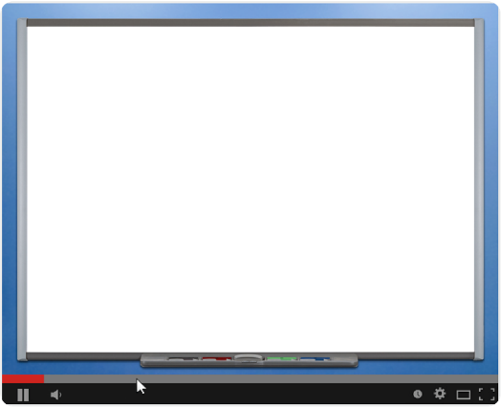
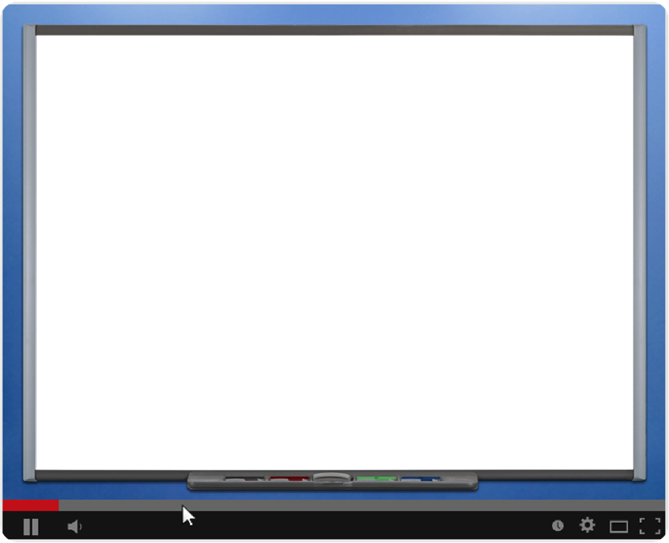
CONCLUSION
Notes:
Good work! Thank you for completing the module on selected-response items. Please view additional modules to continue your learning.

