Slide 1
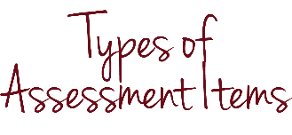
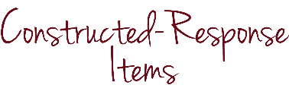
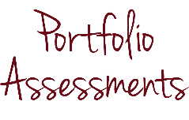
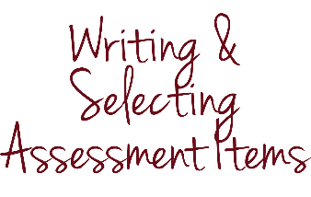
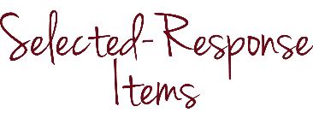
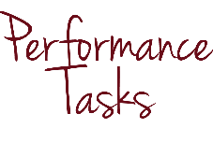
Types of
Assessment items
Notes:
This module focuses on the types of assessment items teachers design all the time, although “item” might not be a term that you hear frequently. Assessment experts use the term “item” as opposed to question for reasons that we will soon discuss.

Slide 2


INTRODUCTION & PURPOSE
Identify, describe and tell the difference between three different TYPES OF ASSESSMENT ITEMS
Notes:
By the end of this module, you should be able to identify, describe and tell the difference between three different types of assessment items.

Slide 3
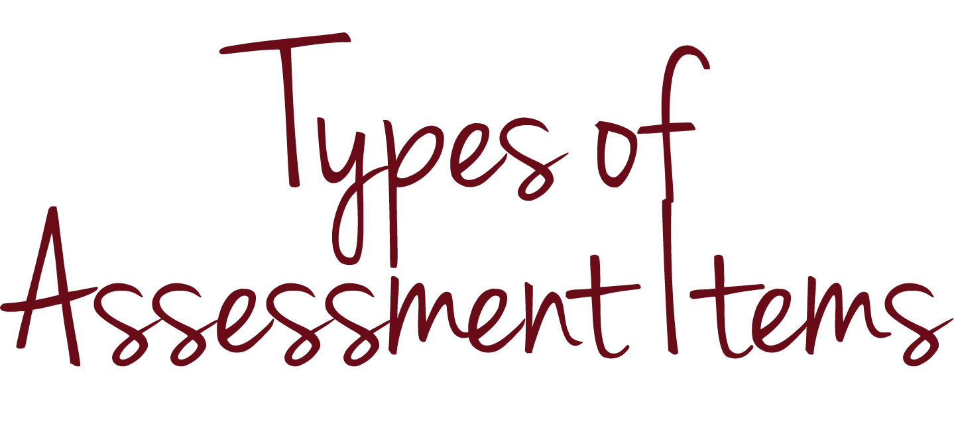
KEY CONCEPTS
Notes:
Now, let’s get started.

Slide 4
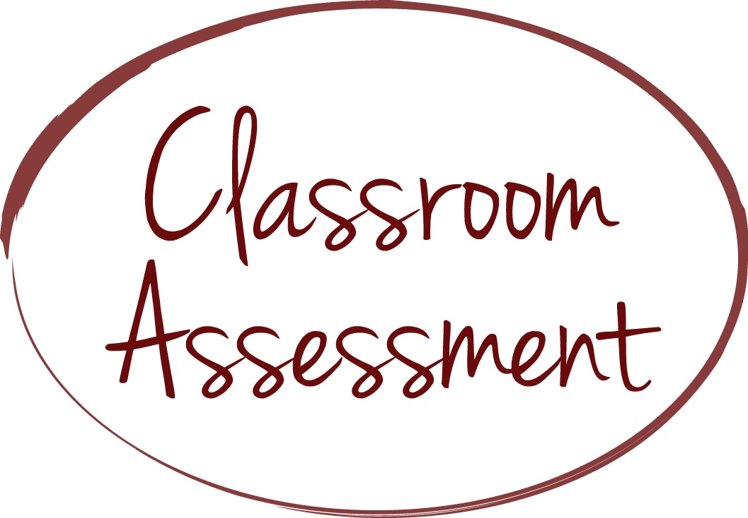

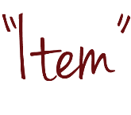






KEY CONCEPTS
?
?
?
?
Notes:
In this series of modules, we consider an “assessment” to be a compilation of one or more of what we often think of as questions students answer. Assessment experts usually use the term “item” instead of “question” because, as we will see, an assessment item is not always written as a question.

Slide 5





KEY CONCEPTS
Notes:
This module focuses on three types of assessment items: (1) selected-response items, (2) constructed-response items and performance tasks. While you likely already have experience writing or selecting these types of assessment items, we’re taking the time now to define these terms to establish a common understanding that we’ll use throughout the modules in this series.

Slide 6
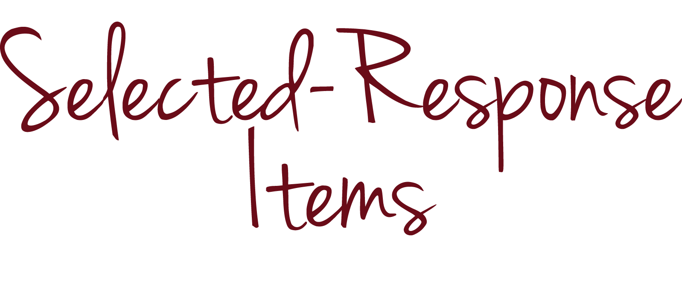
KEY CONCEPTS

Slide 7





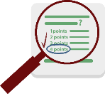


KEY CONCEPTS
Students select a response
Sources: Kansas State Department of Education, Assessment Literacy Project; Ohio Department of Education, “How to Design and Select Quality Assessments;” Relay Graduate School of Education, Designing and Evaluating Assessments (2014); Rhode Island Department of Education, “Deepening Assessment Literacy.”
Notes:
Selected-response items ask students to select the correct answer from a list of options included in the item. Examples of selected-response items include matching, true/false and multiple choice.

Slide 8


KEY CONCEPTS
What kind of an animal is a chameleon?
  mammal
  reptile
  bird
  insect
Notes:
For example:
What kind of an animal is a chameleon?
mammal
reptile
bird
insect

Slide 9
KEY CONCEPTS
Is the following statement true or false?
A chameleon is a type of lizard.
Notes:
Or:
Is the following statement true or false?
A chameleon is a type of lizard.

Slide 10

KEY CONCEPTS
Students select a response
Notes:
We use answer keys and scoring guides to score these items.

Slide 11
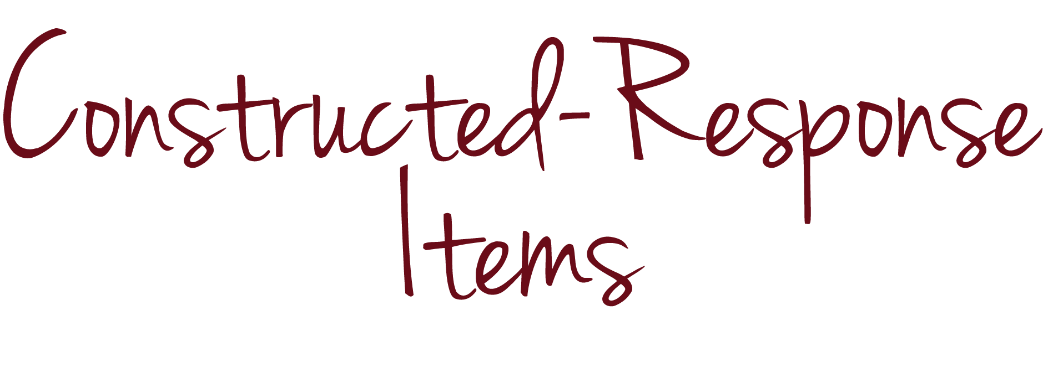
KEY CONCEPTS

Slide 12



KEY CONCEPTS
Students construct a response
Sources: Kansas State Department of Education, Assessment Literacy Project; Ohio Department of Education, “How to Design and Select Quality Assessments;” Relay Graduate School of Education, Designing and Evaluating Assessments (2014); Rhode Island Department of Education, “Deepening Assessment Literacy.”
Notes:
Constructed-response items ask students to write, or “construct,” the correct answer. We use answer keys to score simpler constructed-response items, such as fill-in-the-blank items.

Slide 13
KEY CONCEPTS
The chameleon is a distinctive and well-known species of
________________.
Notes:
For example: The chameleon is a distinctive and well-known species of “BLANK.”

Slide 14
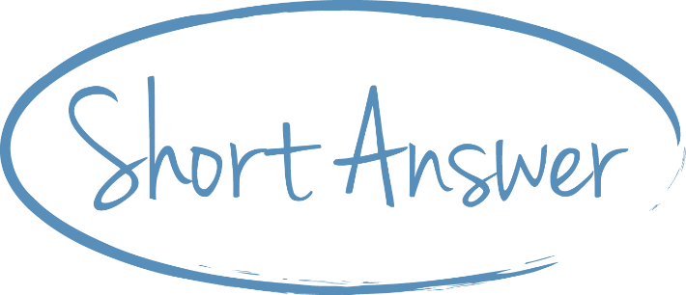
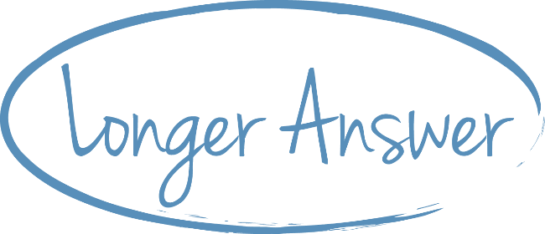
KEY CONCEPTS
Students construct a response
Notes:
We use scoring guides to score more complex constructed-response items, such as short- and longer-answer items.

Slide 15
KEY CONCEPTS
Describe at least three distinguishing features of chameleons. Use complete sentences.
Notes:
For example: Describe at least three distinguishing features of chameleons. Use complete sentences.

Slide 16


KEY CONCEPTS
Notes:
We can think of constructed-response items as short, written performance tasks.

Slide 17
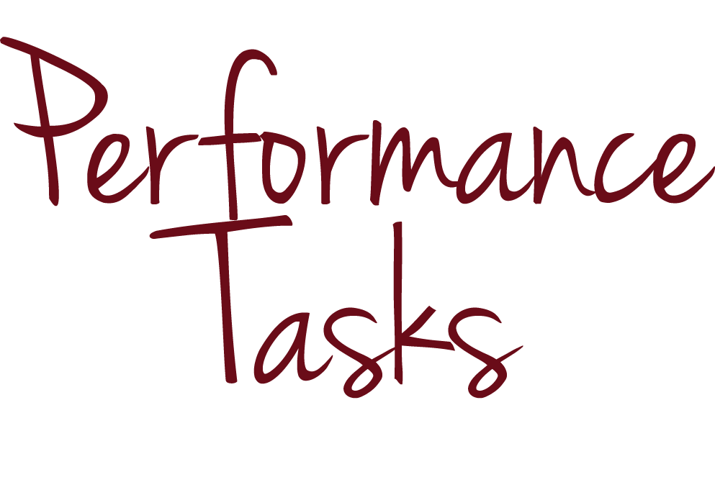
KEY CONCEPTS

Slide 18






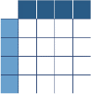

KEY CONCEPTS
Students create products or perform tasks to show their mastery of a particular skill
Sources: Kansas State Department of Education, Assessment Literacy Project; Ohio Department of Education, “How to Design and Select Quality Assessments;” Relay Graduate School of Education, Designing and Evaluating Assessments (2014); Rhode Island Department of Education, “Deepening Assessment Literacy.”
Notes:
Performance tasks ask students to create products or perform tasks to show their mastery of particular skills. They take a wide variety of forms. Performance tasks can be extended-response items or essays. They can also involve multiple steps that culminate in a product, such as carrying out an experiment, giving a speech or writing a research paper. We use scoring guides and rubrics to score all types of performance tasks.

Slide 19
KEY CONCEPTS
Notes:
We often combine assessment items from these three categories to create a single assessment. For example, at one time or another, you have probably combined several multiple-choice and short-answer items to create a single assessment.

Slide 20
KEY CONCEPTS
Notes:
Or you may have used a single performance task as its own entire assessment.

Slide 21
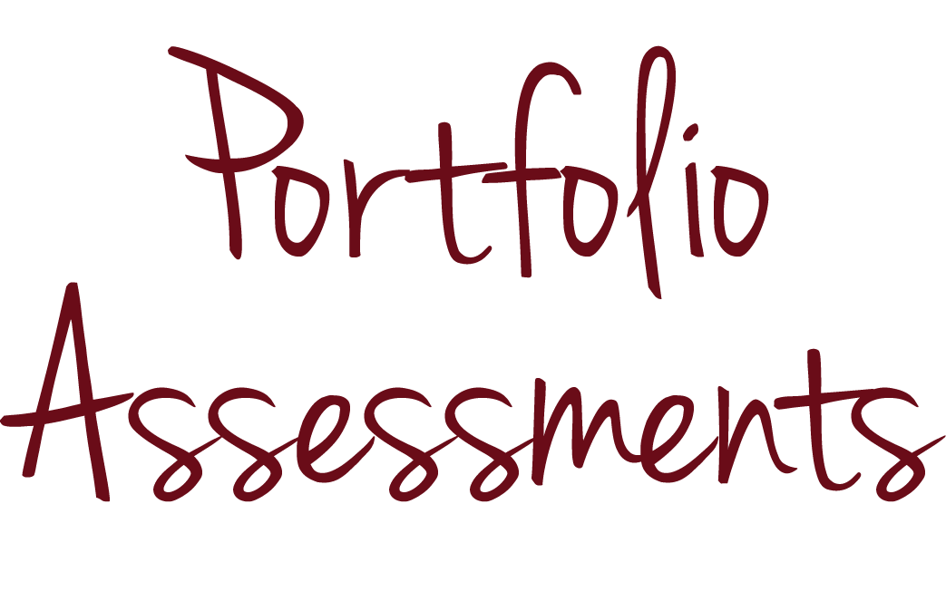
KEY CONCEPTS

Slide 22


KEY CONCEPTS
Source: Kansas State Department of Education, Assessment Literacy Project.
Notes:
Portfolio assessments are not a type of assessment item, but rather a compilation of student work.

Slide 23





KEY CONCEPTS
Students or teachers collect student work products
Source: Kansas State Department of Education, Assessment Literacy Project.
Notes:
Portfolio assessments ask students or teachers to collect work products that show growth over a specific period of time. Examples of work products include collections of student essays, artwork, lab reports or reading logs. We use scoring guides and rubrics to score portfolios.

Slide 24
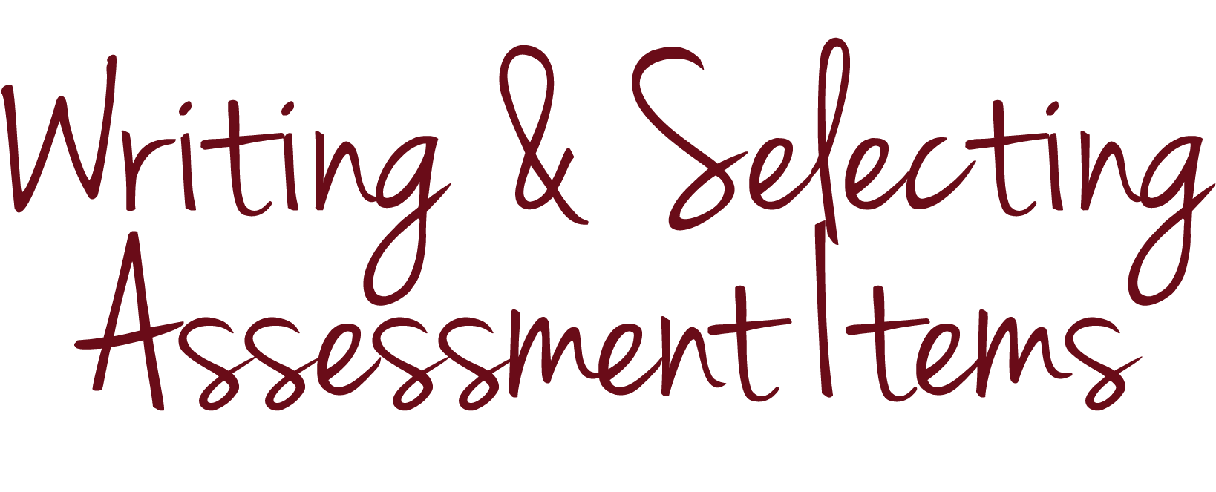
KEY CONCEPTS

Slide 25





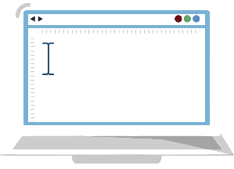






KEY CONCEPTS
Notes:
While you likely have experience writing your own assessments and items entirely from scratch, you have probably also selected assessment items from curriculum materials. You may also have tried to compile an assessment from an online item “bank,” which several States, districts and curriculum developers have created to help teachers. You may have found that it is less time consuming to select an existing assessment or compile pre-written items than it is to write an assessment from scratch. However, don’t assume that these assessments from curriculum materials or item banks are well designed. As you’ve probably noticed, they vary in quality, which is why expertise in assessment design, particularly the ability to select well-designed assessments, is important for all educators, not just teachers who need to write assessments from scratch.

Slide 26
CHECK FOR UNDERSTANDING
Notes:
We have addressed the key concepts in this module, so let’s review our goal.

Slide 27
CHECK FOR UNDERSTANDING
Identify, describe and tell the difference between three different TYPES OF ASSESSMENT ITEMS
Notes:
At the outset of the module, we set a goal that you would be able to able to identify, describe and tell the difference between three different types of assessment items.

Slide 28
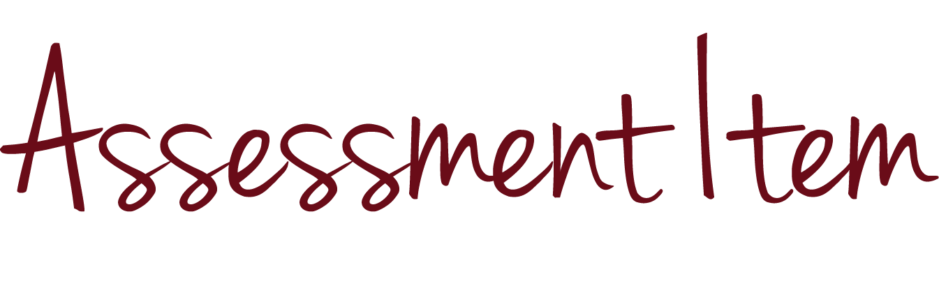
CHECK FOR UNDERSTANDING
Notes:
To determine whether we have achieved our goal, let’s check your understanding with an assessment item.

Slide 29
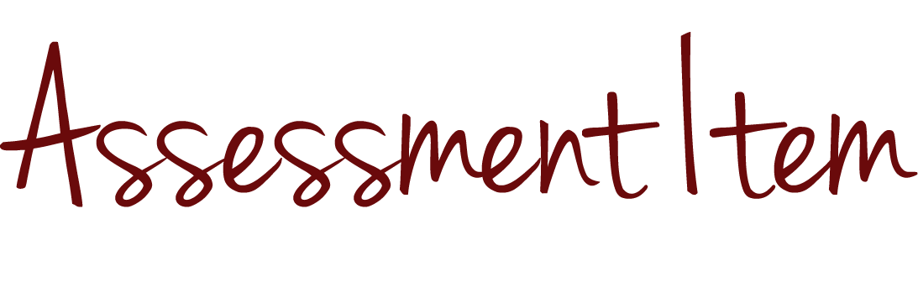
CHECK FOR UNDERSTANDING
Compare and contrast the three types of assessment items we discussed in this module according to how students demonstrate learning.
Notes:
Here’s the item:
Compare and contrast the three types of assessment items we discussed in this module according to how students demonstrate learning.

Slide 30


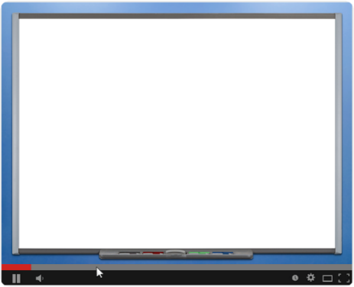
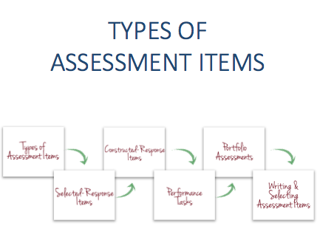

CHECK FOR UNDERSTANDING
Compare and contrast the three types of assessment items we discussed in this module according to how students demonstrate learning.
Notes:
Pause this video if you want a few moments to think about your answer or discuss it with colleagues.

Slide 31
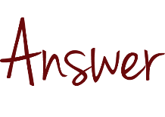
CHECK FOR UNDERSTANDING
  Compare and contrast the three types of assessment items we discussed in this module according to how students demonstrate learning.
  A sample answer to the item would be: Selected-response items ask students to select the correct answer from a list of options included in the item, while constructed-response items ask students to write, or construct, the correct answer instead of selecting it. Constructed-response items are similar to written performance tasks, which ask students to create products or perform tasks to show their mastery of particular skills. Unlike constructed-response items, performance tasks can also include verbal or physical tasks.
Notes:
A sample answer to the item would be: Selected-response items ask students to select the correct answer from a list of options included in the item, while constructed-response items ask students to write, or construct, the correct answer instead of selecting it. Constructed-response items are similar to written performance tasks, which ask students to create products or perform tasks to show their mastery of particular skills. Unlike constructed-response items, performance tasks can also include verbal or physical tasks.

Slide 32

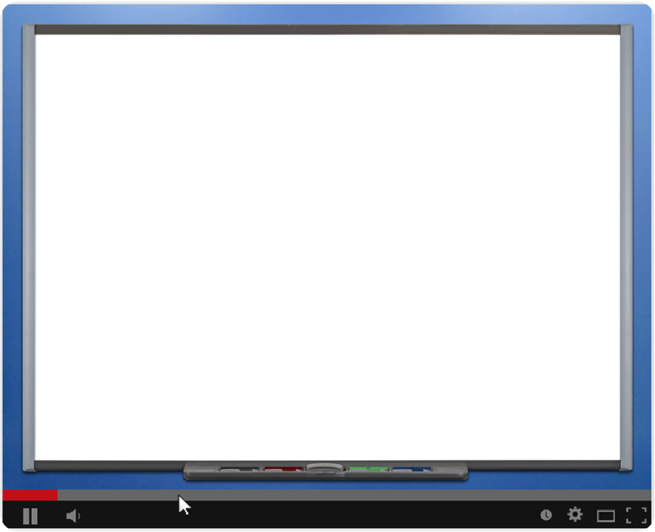
CONCLUSION
Notes:
Good work! Thank you for completing the module on types of assessment items. Please view additional modules to continue your learning.

