Slide 1
Munching on Math
1
Task
Topic
Ratios and Proportions
Common Core State Standards
8EE5
Copyright @ 2016 The Regents of the University of California
This work was supported by grant number #DRL-1020393 from the National Science Foundation and grant number 2012-8075 from the William and Flora Hewlett Foundation.

Slide 2
Agenda
Set Up
Mind Stretch
Workout
Check Your Pulse
Final Lift
Whole class, 5 min
Whole class, 5 min
Individual, 10-15 min
Pairs, Individual, Whole class, 10 min
Individual, 15 min

Slide 3
How can we use math to predict the future if a trend continues?
Setup

Slide 4
Learning Goals & Expectations
We will understand/ be able to…
Describe the term unit rate.
Represent unit rate in multiple ways.
Apply proportional reasoning to compare rates.
We will be successful when we…
Use unit rate to complete a table, diagram, and graph.
Determine unit rate from given information.
Compare two rates and explain how the unit rate can be found on a graph.

Slide 5
High Quality Work
Work is accurate & precise
Problem is set up in a way that helps you solve it.
Scale: responses use appropriate units.
Work has been checked for calculation errors.
Explanations
Describe what you did and why you did it.
Use multiple representations to show your thinking about math.
Include a logical argument and evidence to support each answer. It makes sense.

Slide 6
Multiple Representations
Use multiple representations to help you think and to show your thinking to others.
Representations
Create a chart or table
Set up an equation or an algebraic rule
Sketch a graph
Use words to explain and justify

Slide 7
Prior Knowledge
What do these have in common?
Strikeouts: Walks
Distance per time
Flour
Sugar
A to B

Slide 8
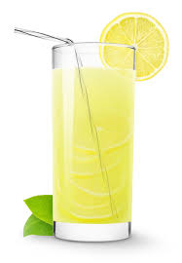
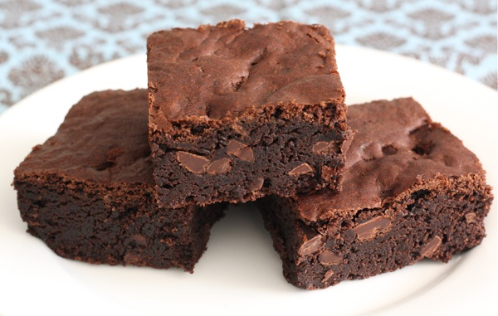
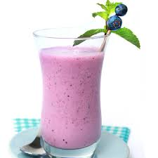
The story so far…
Cosmo is starting a business. He keeps track of how much he sells each day. He wants to predict how much he will sell in the future, assuming the same rates of sales. To do this he will calculate a unit rate. The unit rate is a ratio of one quantity to one unit of another quantity.

Slide 9
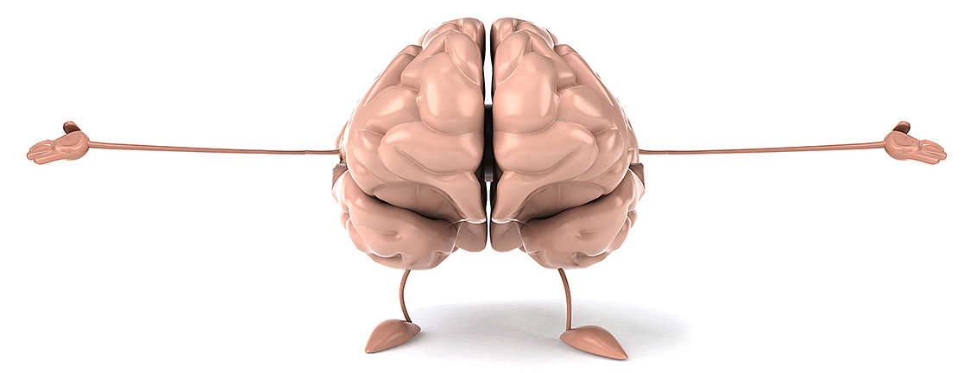
Mind Stretch

Slide 10
Mind Stretch
Fill in the table, then graph, complete the tape diagram, and write the sentence…
Then complete the following sentences in your own words …
Unit rate means ….
An example of a unit rate is …..

Slide 11
Workout

Slide 12
Workout
Cosmo’s Cosmic Café sold 9 brownies in 2 hours.
Assuming that Cosmo sells brownies at the same rate each hour.
Complete the table and graph.
How many brownies did Cosmo sell in 1 hour (i.e., the unit rate)?
Where do you see the unit rate in the graph? Explain.

Slide 13
Check
Your Pulse

Slide 14
Check Your Pulse
Compare your answers with a partner. Then discuss…
Where do you agree or disagree with your partner’s answer?
What part(s) were difficult for you?

Slide 15
Check Your Pulse
On your own… self-assess:
Circle your level of understanding for the Workout.
I have lots of questions. I need help
Almost got it, but I need practice
Got it. I can explain this to a classmate.

Slide 16
Final Lift

Slide 17
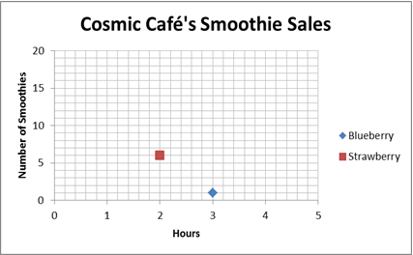
Final Lift
Cosmo’s Café graphed their sales of fruit smoothies.
How many blueberry smoothies do you think Cosmo sold in zero hours? Why?
Based on your reasoning above, how may strawberry smoothies do you think Cosmo sold in zero hours?
According to the graph, how many strawberry smoothies did the cafe sell in each hour if Cosmo sells strawberry smoothies at a constant rate.

Slide 18
Final Lift
Cosmo’s Café graphed their sales of fruit smoothies.
Compare the rate of sales of strawberry smoothies to blueberry smoothies.
At these rates, will Cosmic Café ever sell the same number of blueberry smoothies as strawberry smoothies in the same number of hours? Why or why not?

Slide 19
Final Lift (cont.)
Cosmo’s Café is growing their own fruit.
Over one month:
A lemon tree grew from 100 to 112 centimeters
A strawberry plant grew from 10 to 20 centimeters
Cosmo says that the lemon tree grew more than the strawberry plant, but his gardener disagrees.

Slide 20
Final Lift (cont.)
To support his thinking, Cosmo said the lemon tree grew 12 centimeters (112-110) and the strawberry plant grew 10 centimeters (20-10).
The gardener observed that the lemon tree grew 12% but the strawberry plant grew 100%.
Who do you think is right? Explain your thinking.

