Slide 1
End of Las Vegas?
4
Task
Topic
Proportional Relationships, Lines & Linear Equations
Common Core State Standards
8EE5
Copyright @ 2016 The Regents of the University of California
This work was supported by grant number #DRL-1020393 from the National Science Foundation and grant number 2012-8075 from the William and Flora Hewlett Foundation.

Slide 2
Agenda
Set Up
Mind Stretch
Workout
Check Your Pulse
Final Lift
Whole class, 5 min
Whole class, 5 min
Individual, 10-15 min
Pairs, Individual, Whole class, 10 min
Individual, 15 min

Slide 3

How can we use math to think about big problems in our world?
Setup

Slide 4
Learning Goals & Expectations
We are learning to…
Make connections between representations of the same rate.
Compare and contrast different rates.
Identify where slope changes within a graph.
We will be successful when we…
Connect equations, figures and graphs that represent the same rate.
Explain how an equation, figure, and graph are related to one another.
Interpret a graph, describing the slope and any change of slope.

Slide 5
High Quality Work
Work is accurate & precise
Problem is set up in a way that helps you solve it.
Scale: responses use appropriate units.
Work has been checked for calculation errors.
Explanations
Describe what you did and why you did it.
Use multiple representations to show your thinking about math.
Include a logical argument and evidence to support each answer. It makes sense.

Slide 6
Multiple Representations
Use multiple representations to help you think and to show your thinking to others.
Representations
Create a chart or table
Set up an equation or an algebraic rule
Sketch a graph
Use words to explain and justify

Slide 7
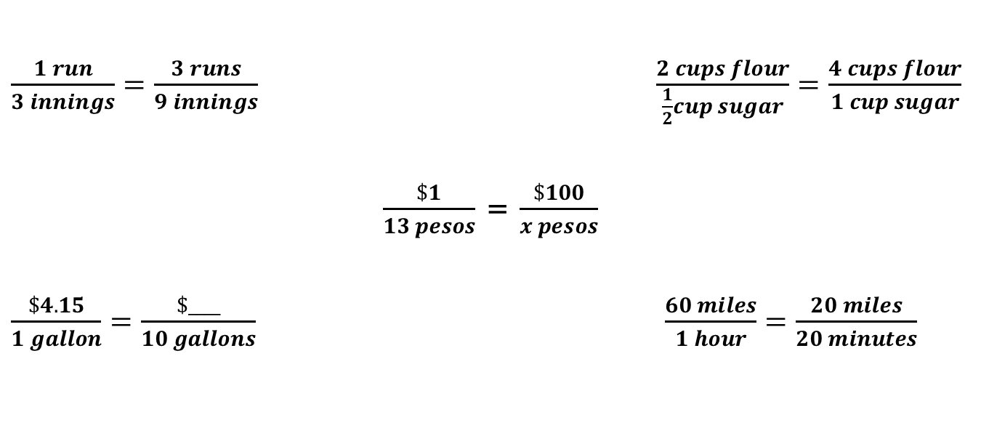
Prior Knowledge
Earned Run Average
More mouths to feed
Currency Exchange
Fill ‘er up
“When will we get there?”

Slide 8
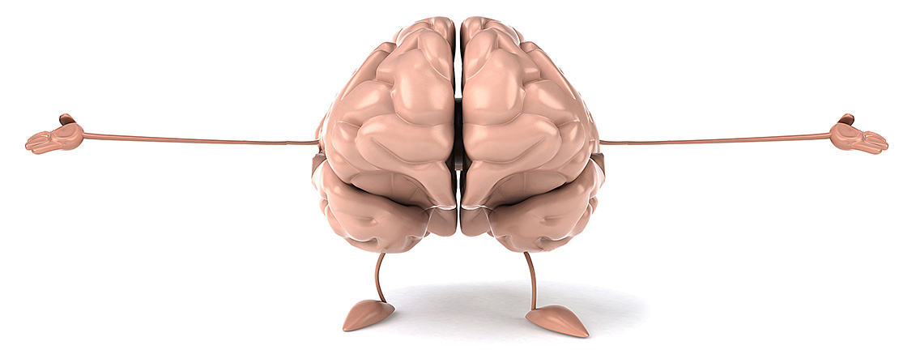
Mind Stretch

Slide 9
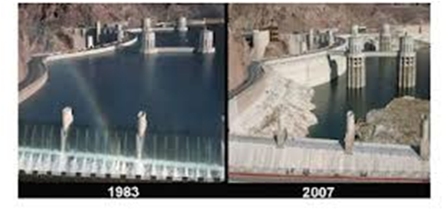
The story so far…
Nevada and California are in the middle of a drought. Unless something changes, Las Vegas may soon run out of water. The lake that supplies 90% of the water for Las Vegas, Lake Mead, will be at a level so low by 2021 that it will not provide any water.
Lake Mead Water Levels

Slide 10

Mind Stretch
An average shower uses 5 gallons of water per minute.
About how many minutes do you spend showering each day?
Show how you would estimate the number of gallons of water you use showering for this many minutes each day.
Show how you would estimate the number of gallons of water you use showering in one week (7 days)?
Write an equation showing how many gallons of water you use showering in x days. Use the variable y to represent the gallons of water used.

Slide 11

Workout

Slide 12
Workout
Facts:
Las Vegas uses water at a rate of 219 gallons per person per day.
Los Angeles uses water at a rate of 123 gallons per person per day.
San Francisco uses water at a rate of 49 gallons per person per day.
Sketch a line to represent each city’s water use per person over time on the same graph.
Explain how use of water per person in Las Vegas, Los Angeles, and San Francisco compare over time

Slide 13
Workout (cont.)
Researchers calculated how much water each city uses per year (in acre feet).
Acre foot: unit of volume. An area of one acre filled to a depth of one foot. 1 acre foot = 325,851 gallons
They created graphs, equations, and pictures to represent how each city’s water storage declines with every day of water use.
Take out your End of Vegas cards to complete the workout. Match the graph, equation and picture cards for each city.
Attach the graph, equation and picture card for Los Angeles to your worksheet.
Explain how you know these are the correct representations for the water use in Los Angeles. In your answer, please explain what specific information from each representation connects it to the water use in Los Angeles.

Slide 14

Check
Your Pulse

Slide 15
Check Your Pulse
Compare your answers with a partner. Then discuss…
Where do you agree or disagree with your partner’s answer?
What part(s) were difficult for you?

Slide 16

Check Your Pulse
On your own… self-assess:
Circle your level of understanding for the Workout.
I have lots of questions. I need help
Almost got it, but I need practice
Got it. Ready to move on.

Slide 17

Final Lift

Slide 18
Final Lift
During the drought each household gets a water “allowance” of 200 gallons per day. This is a graph of how a family used water from 6am to 6pm on a Saturday.
How much water is left?
B

Slide 19
Final Lift
Label the graph at points where the slope changes.
Based on the graph, describe how the slope changes at each point and what might be happening.
Which of the given equations fits segment drawn between 6:00 AM and 8:00 AM?
Does the answer you circled above suggest a proportional relationship between x and y? Explain.

Slide 20
Final Lift (Continued)
Does the slope of the line on the graph change, or is it constant, between 6:00 AM and 6:00 PM? Explain your thinking.
If the family cuts their water use in half between 6 AM and 8 AM, how would the line on the graph change? As part of your answer, explain why you think this.
If the family cuts their water use in half between 6 AM and 8 AM, how would the equation you selected change? As part of your answer, explain why you think this.

Slide 21
Challenge
The mayor of LA challenges the mayor of Las Vegas, saying, “We will reduce our water use more than you.” Las Vegas’ mayor accepts the challenge.
During the next year:
LA cuts water use from 123 gallons to 61 gallons per person per day.
Las Vegas cuts water use from 219 to 139 gallons per person per day.
Los Angeles has about 15 million residents; Las Vegas has about 2 million residents.
Who cut their water use more? Explain your reasoning.

