Slide 1
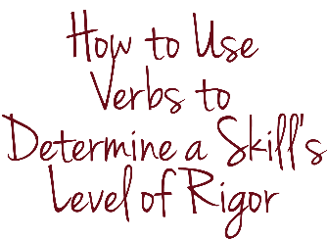
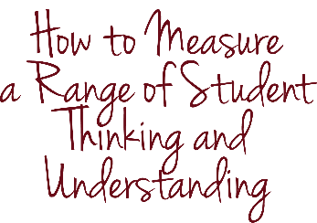
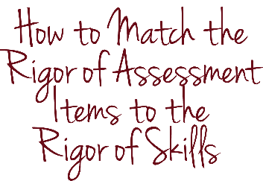
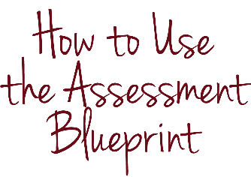
rigor
Alternative module using
webb’s depth of knowledge
Notes:
Rigor. That’s what you bring to your instruction every day. You make sure that your students work hard and think hard each and every lesson. You also want to bring rigor to your assessments, which is why rigor is an element of assessment design.

Slide 2
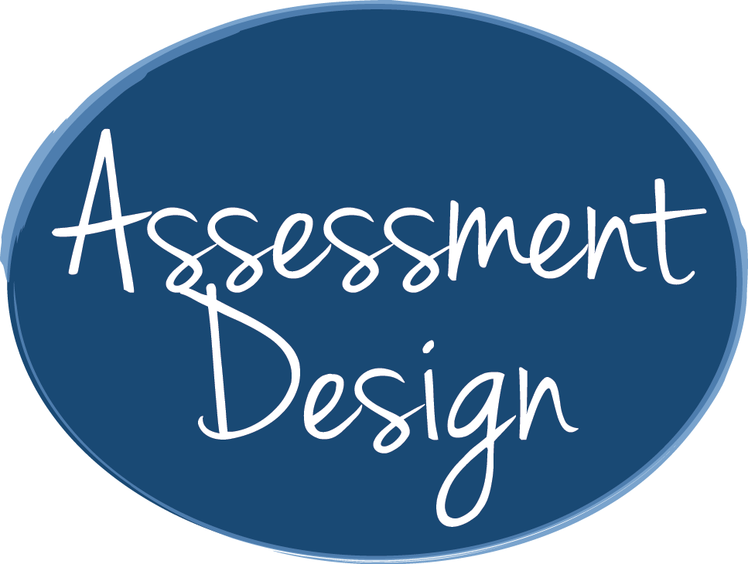
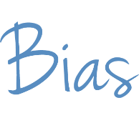
KEY CONCEPTS
Notes:
Rigor is the focus of this module.

Slide 3
INTRODUCTION & PURPOSE
Define what RIGOR means for the purpose of these modules
Use the VERBS in standards and tools that teachers have available to identify the COGNITIVE COMPLEXITY in standards
Explain why assessments with an appropriate level of rigor also measure a RANGE OF STUDENT THINKING AND UNDERSTANDING
Use the ASSESSMENT BLUEPRINT to document the level of rigor of each skill
Notes:
This module has several goals. By the end of this module, you should be able to (1) define what rigor means for the purpose of these modules; (2) use the verbs in standards and tools that teachers have available to identify the cognitive complexity in the relevant standards; (3) explain why assessments with an appropriate level of rigor also measure a range of student thinking and understanding; and (4) use the assessment blueprint to document the level of rigor of each skill you are measuring in assessments you write or select. The level of rigor of this module is high!

Slide 4
KEY CONCEPTS
Notes:
Let’s get started.

Slide 5
KEY CONCEPTS
rigor
the cognitive complexity of a skill within a standard or of an assessment item
Notes:
For the purpose of this series of modules, rigor is the cognitive complexity of a skill within a standard or of an assessment item.

Slide 6
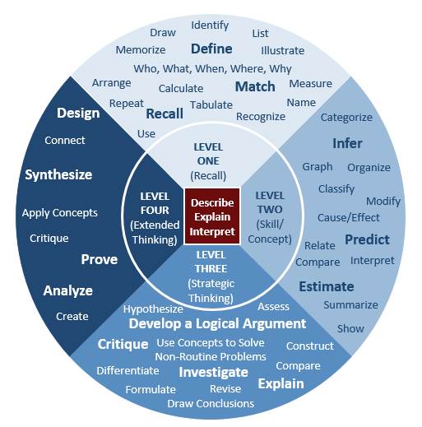
KEY CONCEPTS
Sources: Kansas State Department of Education, “Assessment Literacy Project”; Ohio Department of Education, “Assessment Literacy: Identifying and Developing Valid and Reliable Assessments” (2013); Relay Graduate School of Education, Designing and Evaluating Assessments (2014); and Rhode Island Department of Education, “Deepening Assessment Literacy.”
Notes:
An assessment has “an appropriate level of rigor” if it includes items that match the level of rigor of the skill or skills you intend students to master. It also has an appropriate level of rigor if it measures a range of student thinking and understanding so that it measures what all students know and can do. We will explore these two aspects of rigor one at a time.

Slide 7
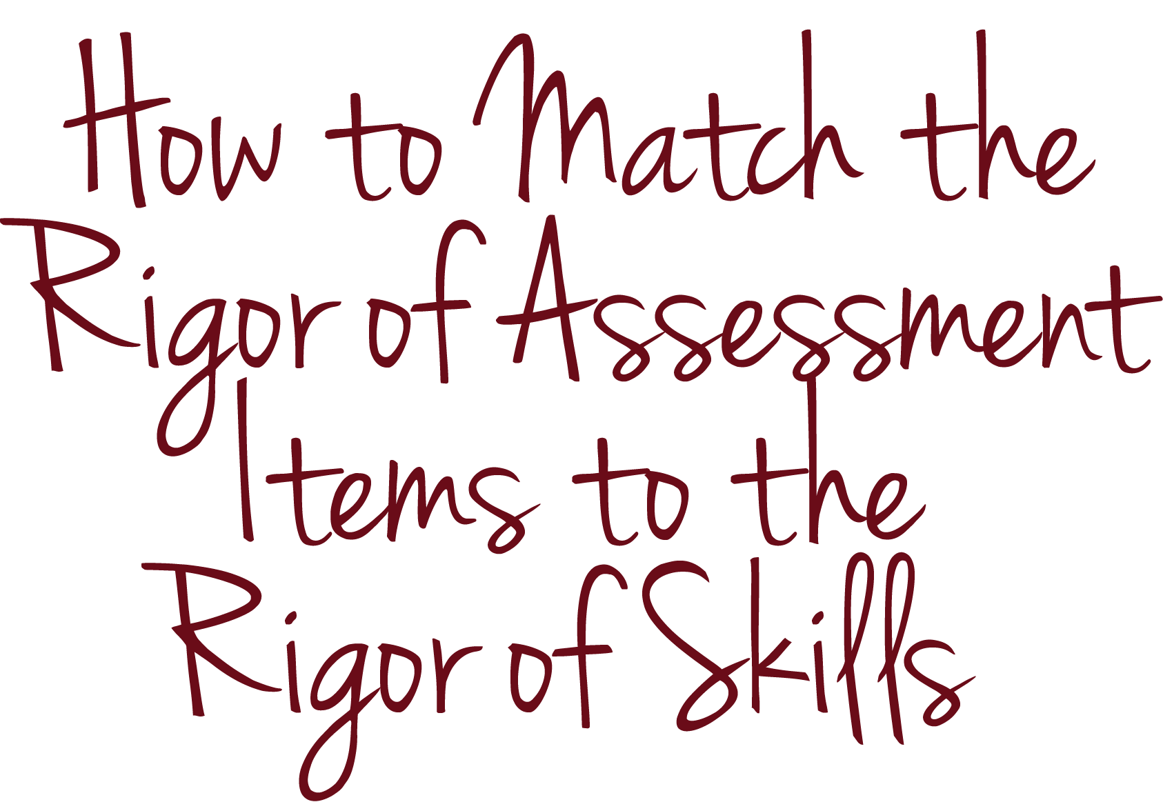
KEY CONCEPTS

Slide 8
KEY CONCEPTS
a
b
c
Notes:
To ensure that the rigor or cognitive complexity of each assessment item matches the rigor or cognitive complexity of the skill you intend it to assess, you can study the standard to determine the complexity of each skill embedded within it.

Slide 9
KEY CONCEPTS
Interpret whole-number quotients of whole numbers, e.g., interpret 56 ÷ 8 as the number of objects in each share when 56 objects are partitioned equally into 8 shares, or as a number of shares when 56 objects are partitioned into equal shares of 8 objects each. For example, describe a context in which a number of shares or a number of groups can be expressed as 56 ÷ 8.
Source: Tennessee Department of Education, “Tennessee’s State Mathematics Standards: Grade 3” (2010).
Notes:
For example, let’s consider the third-grade mathematics standard from Tennessee that we discussed in the module about alignment.
Interpret whole-number quotients of whole numbers, e.g., interpret 56 ÷ 8 as the number of objects in each share when 56 objects are partitioned equally into 8 shares, or as a number of shares when 56 objects are partitioned into equal shares of 8 objects each. For example, describe a context in which a number of shares or a number of groups can be expressed as 56 ÷ 8.

Slide 10
KEY CONCEPTS
Interpret whole-number quotients of whole numbers, e.g., interpret 56 ÷ 8 as the number of objects in each share when 56 objects are partitioned equally into 8 shares, or as a number of shares when 56 objects are partitioned into equal shares of 8 objects each. For example, describe a context in which a number of shares or a number of groups can be expressed as 56 ÷ 8.
Interpret whole-number quotients of whole numbers.
Notes:
In the module about alignment, we unpacked this standard into a single skill: Interpret whole-number quotients of whole numbers.

Slide 11
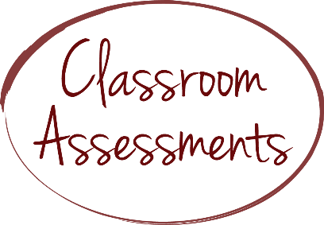
KEY CONCEPTS
Interpret whole-number quotients of whole numbers.
What is 12 ÷ 3?
Notes:
We also explained that the item “What is 12 ÷ 3?” is well aligned with the content of the standard because it asks students to work with the whole-number quotient of whole numbers.

Slide 12
KEY CONCEPTS
Interpret whole-number quotients of whole numbers.
What is 12 ÷ 3?
Notes:
However, we cannot assume a student’s mastery of this standard just because he or she answers it correctly. This is because the rigor of this specific item does not match the cognitive complexity of the standard.

Slide 13
KEY CONCEPTS
Interpret whole-number quotients of whole numbers, e.g., interpret 56 ÷ 8 as the number of objects in each share when 56 objects are partitioned equally into 8 shares, or as a number of shares when 56 objects are partitioned into equal shares of 8 objects each. For example, describe a context in which a number of shares or a number of groups can be expressed as 56 ÷ 8.
What is 12 ÷ 3?
Notes:
The standard states that students must be able to interpret the answer to a division problem involving whole numbers, not simply calculate it. Interpretation and calculation require different skill sets. Interpretation is more complex than calculation.
An assessment would need to include a different item or additional items to measure whether students have mastered interpretation.

Slide 14
KEY CONCEPTS
Interpret whole-number quotients of whole numbers, e.g., interpret 56 ÷ 8 as the number of objects in each share when 56 objects are partitioned equally into 8 shares, or as a number of shares when 56 objects are partitioned into equal shares of 8 objects each. For example, describe a context in which a number of shares or a number of groups can be expressed as 56 ÷ 8.
Suppose there are 4 tanks and 3 fish in each tank. The total number of fish in this situation can be expressed as 4 × 3 = 12.
Describe what is meant in this situation by 12 ÷ 3 = 4
Describe what is meant in this situation by 12 ÷ 4 = 3
Source: “Fish Tanks,” Illustrative Mathematics.
Notes:
For example, here is an item that you might add to your assessment so that it measures mastery of the actual standard:
Suppose there are 4 tanks and 3 fish in each tank. The total number of fish in this situation can be expressed as 4 × 3 = 12.
a. Describe what is meant in this situation by 12 ÷ 3 = 4.
b. Describe what is meant in this situation by 12 ÷ 4 = 3.
Unlike “What is 12 ÷ 3?,” this item asks students to interpret whole-number quotients of whole numbers within a real-life context.

Slide 15
KEY CONCEPTS
Suppose there are 4 tanks and 3 fish in each tank. The total number of fish in this situation can be expressed as 4 × 3 = 12.
Describe what is meant in this situation by 12 ÷ 3 = 4
Describe what is meant in this situation by 12 ÷ 4 = 3
Notes:
This is what we mean when we say that the item has an appropriate level of rigor. In the above example, the cognitive complexities of both the item and the standard match.

Slide 16
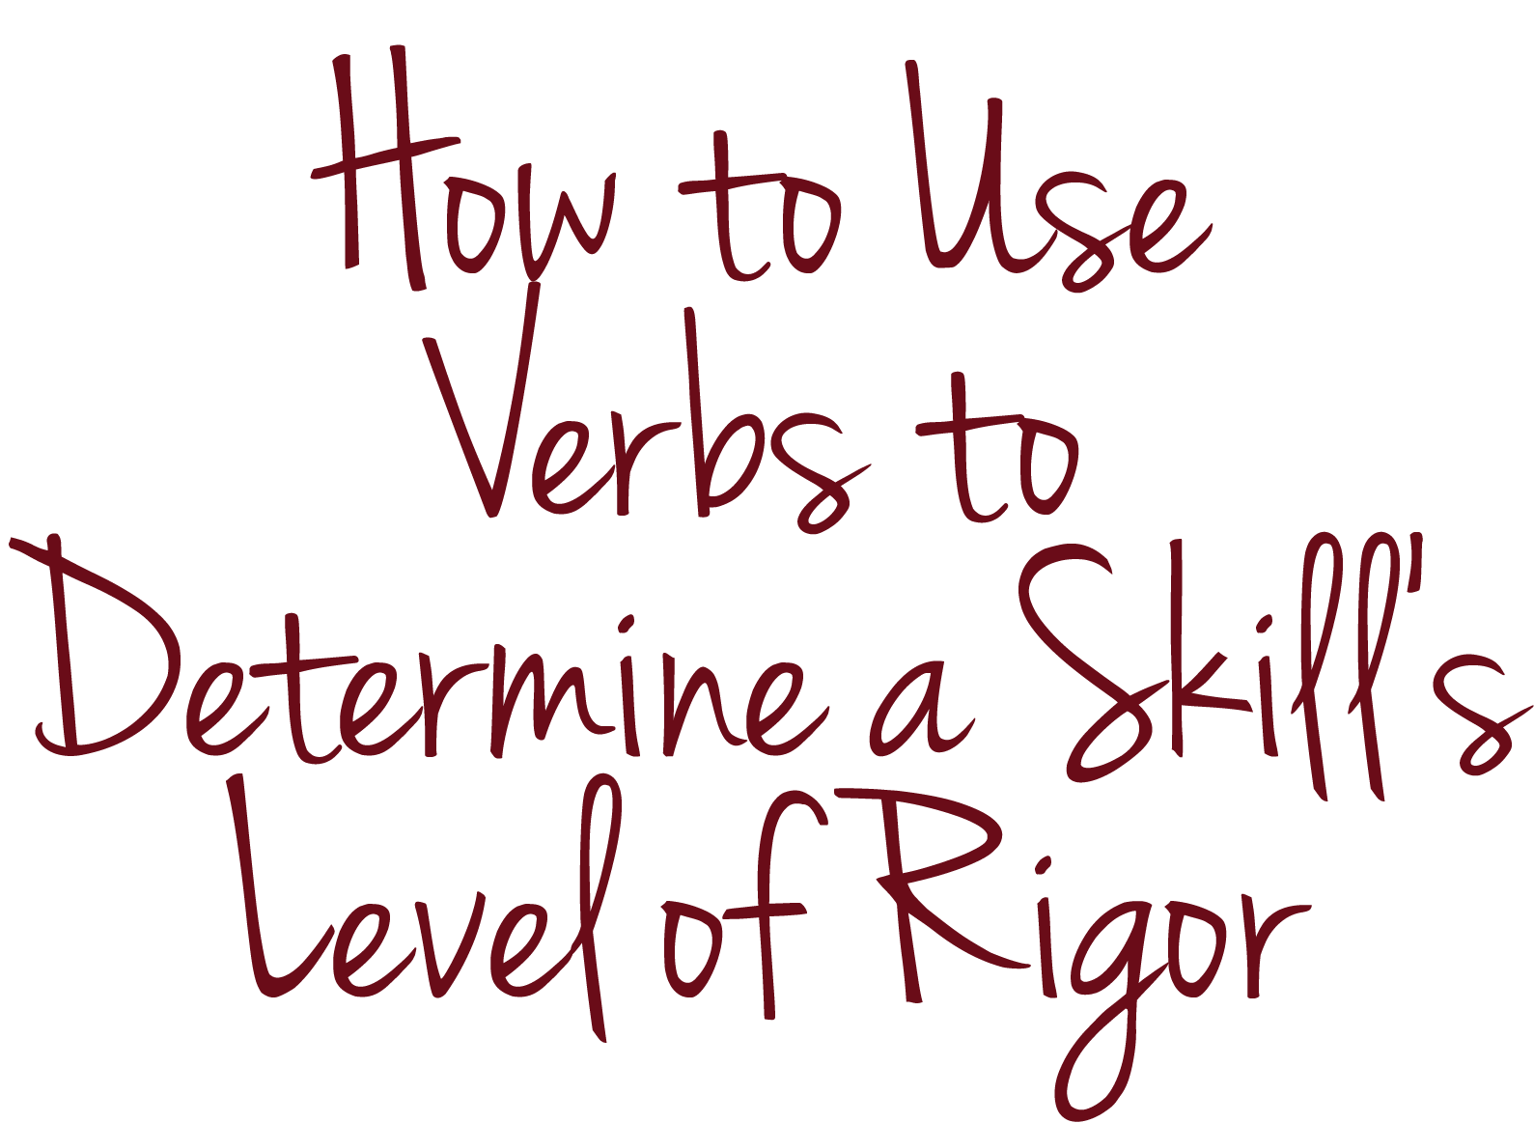
KEY CONCEPTS

Slide 17
KEY CONCEPTS
Interpret whole-number quotients of whole numbers, e.g., interpret 56 ÷ 8 as the number of objects in each share when 56 objects are partitioned equally into 8 shares, or as a number of shares when 56 objects are partitioned into equal shares of 8 objects each. For example, describe a context in which a number of shares or a number of groups can be expressed as 56 ÷ 8.
Notes:
It is easy to misjudge the rigor in a standard. One common pitfall is to use important words found in the standards to simplify complicated standards. For example, you might think of the standard in the previous example as “the division standard” for third grade and ignore the part of the skill in the standard that requires a student to interpret the answer to a division problem.

Slide 18
KEY CONCEPTS
Interpret whole-number quotients of whole numbers, e.g., interpret 56 ÷ 8 as the number of objects in each share when 56 objects are partitioned equally into 8 shares, or as a number of shares when 56 objects are partitioned into equal shares of 8 objects each. For example, describe a context in which a number of shares or a number of groups can be expressed as 56 ÷ 8.
Notes:
A helpful tip that we will explore in this module is how to use the verbs, in the context of the standard as a whole, to determine a skill’s level of cognitive complexity.

Slide 19
KEY CONCEPTS
Use the relationship between particular words (e.g., synonyms, antonyms, homographs) to better understand each of the words.
Source: New York State Department of Education, “New York State P-12 Common Core Learning Standards for English Language Arts & Literacy” (2010).
Notes:
For example, take this fifth-grade literacy standard from New York. Pay attention to the key verb “use.”

Slide 20
KEY CONCEPTS
Use the relationship between particular words (e.g., synonyms, antonyms, homographs) to better understand each of the words.
Notes:
Use the relationship between particular words (e.g., synonyms, antonyms, homographs) to better understand each of the words.

Slide 21
KEY CONCEPTS
Use the relationship between particular words (e.g., synonyms, antonyms, homographs) to better understand each of the words.
Notes:
If you were to narrow the focus to only a couple of key words in the standard, you might focus only on synonyms and antonyms.

Slide 22
KEY CONCEPTS
Use the relationship between particular words (e.g., synonyms, antonyms, homographs) to better understand each of the words.
Notes:
If you have used a textbook to teach synonyms and antonyms, you might conclude that you have successfully addressed this standard. But what if the goal of the textbook is to do nothing more than help students recognize synonyms and antonyms, and it contains assessment items that test only recognition?

Slide 23
KEY CONCEPTS
Use the relationship between particular words (e.g., synonyms, antonyms, homographs) to better understand each of the words.
Which of the following words is an antonym of “tense”?
troubled
calm
concerned
smooth
Notes:
Here’s an example from that hypothetical textbook:
Which of the following words is an antonym of “tense”?
troubled;
calm;
concerned or
smooth

Slide 24
KEY CONCEPTS
Use the relationship between particular words (e.g., synonyms, antonyms, homographs) to better understand each of the words.
Which of the following words is an antonym of “tense”?
troubled
calm
concerned
smooth
Notes:
This item does not measure mastery of the New York standard because it does not ask students to use the relationship between antonyms to better understand each of the words.

Slide 25
KEY CONCEPTS
Read the passage below. Then answer the question.
Last year my family went to a national park for our vacation. We saw wild animals that we had seen only in books, and we were amazed by the landscape of trees and rivers. The highlight of the trip was an arduous hike we took to the top of a small mountain. Though the hike was not easy, due to all the loose rocks and exposed roots on the path, the spectacular view from the top was worth it!
What does the word “arduous” mean in this passage?
Source: “Part 6 Language, 6.3 Vocabulary Acquisition and Use: Antonyms,” The McGraw-Hill Companies.
Notes:
Here’s an example that can measure mastery of this standard.
Read the passage below. Then answer the question.
Last year my family went to a national park for our vacation. We saw wild animals that we had seen only in books, and we were amazed by the landscape of trees and rivers. The highlight of the trip was an arduous hike we took to the top of a small mountain. Though the hike was not easy, due to all the loose rocks and exposed roots on the path, the spectacular view from the top was worth it!
What does the word “arduous” mean in this passage?

Slide 26
KEY CONCEPTS
Use the relationship between particular words (e.g., synonyms, antonyms, homographs) to better understand each of the words.
Read the passage below. Then answer the question.
Last year my family went to a national park for our vacation. We saw wild animals that we had seen only in books, and we were amazed by the landscape of trees and rivers. The highlight of the trip was an arduous hike we took to the top of a small mountain. Though the hike was not easy, due to all the loose rocks and exposed roots on the path, the spectacular view from the top was worth it!
What does the word “arduous” mean in this passage?
Notes:
This item can measure mastery of this standard because students must use their understanding of antonyms to better understand an unfamiliar word. In this case, a student who does not know the definition of the word “arduous” can look for clue words in the surrounding sentences to infer from the context that “easy” means the opposite of “arduous.” An appropriate student response might be “difficult.” Instead of just recognizing an antonym from a list, as in the previous example, this assessment item requires students to use their understanding of these relationships between words to improve reading comprehension.

Slide 27
KEY CONCEPTS

Slide 28
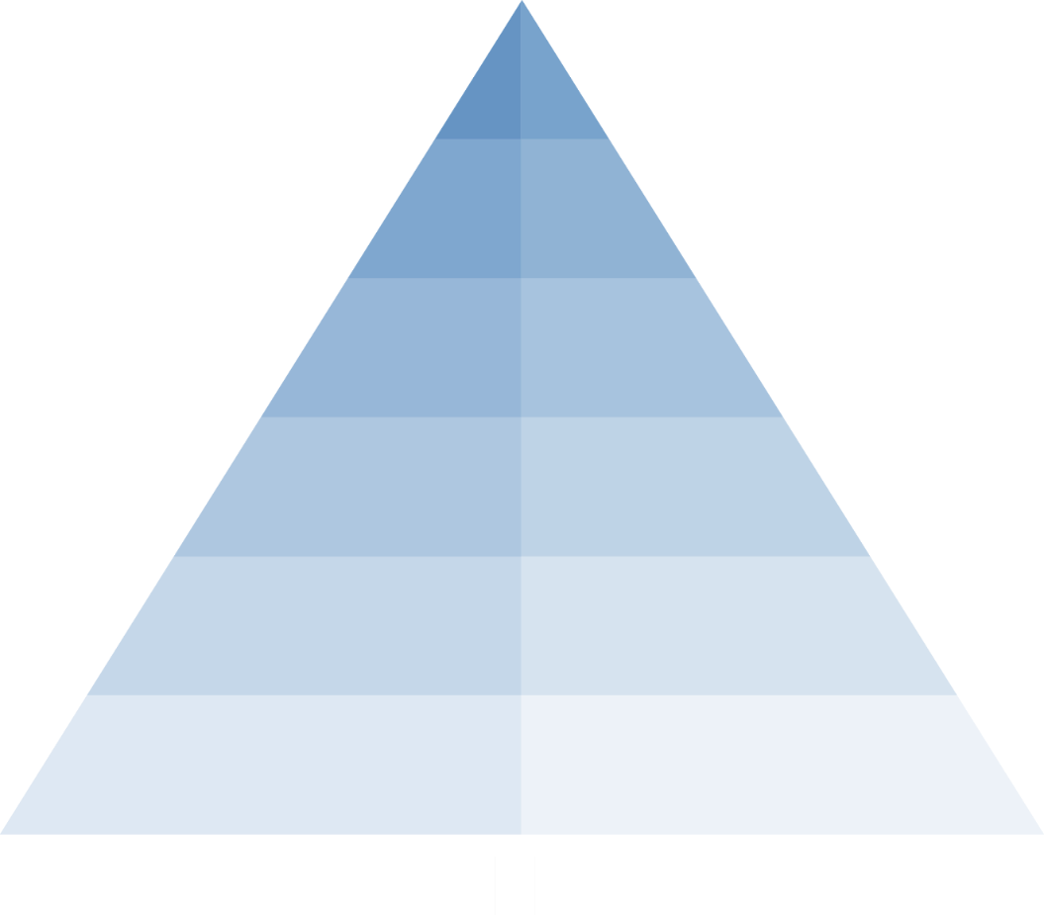
KEY CONCEPTS
Source: Moody, Michael, and Jason Stricker, Strategic Design for Student Achievement (2008).
Notes:
You may be familiar with the different tools experts have developed to help you think about rigor. For example, Bloom’s Taxonomy categorizes cognitive skills into six levels: (1) remembering, (2) understanding, (3) applying, (4) analyzing, (5) evaluating and (6) creating. Lower-order thinking skills, such as remembering, understanding and applying, appear at the bottom of Bloom’s Taxonomy. Higher-order thinking skills, such as analyzing, evaluating and creating, appear at the top of the taxonomy. If Bloom’s Taxonomy is unfamiliar to you, pause this video and take a moment to think about the different skills in each level.

Slide 29
KEY CONCEPTS
Draw
Identify
List
Memorize
Define
Illustrate
Who, What, When, Where, Why
Arrange
Calculate
Match
Measure
Design
Repeat
Recall
Tabulate
Name
Recognize
Categorize
Connect
Use
Infer
LEVEL
ONE
(Recall)
Synthesize
Graph
Organize
LEVEL
FOUR
(Extended Thinking)
LEVEL
TWO
(Skill/ Concept)
Classify
Apply Concepts
Describe Explain Interpret
Modify
Cause/Effect
Critique
Relate
Predict
Prove
LEVEL
THREE
(Strategic Thinking)
Compare
Interpret
Analyze
Estimate
Create
Hypothesize
Assess
Summarize
Develop a Logical Argument
Show
Critique
Use Concepts to Solve Non-Routine Problems
Construct
Differentiate
Investigate
Compare
Formulate
Revise
Explain
Draw Conclusions
Source: Mississippi Department of Education, Webb’s Depth of Knowledge Guide: Career and Technical Education Definitions (2009).
Notes:
Webb’s Depth of Knowledge is another tool to help you think about rigor. Webb’s Depth of Knowledge levels categorize rigor into four levels: (1) recall, (2) skill/concept, (3) strategic thinking and (4) extended thinking. Level 1 skills, such as recalling and matching, require the lowest level of understanding. Level 4 skills, such as creating and analyzing, require the deepest level of understanding.

Slide 30
KEY CONCEPTS
Draw
Identify
List
Memorize
Define
Illustrate
Who, What, When, Where, Why
Arrange
Calculate
Match
Measure
Design
Repeat
Recall
Tabulate
Name
Recognize
Categorize
Connect
Use
Infer
LEVEL
ONE
(Recall)
Synthesize
Graph
Organize
LEVEL
FOUR
(Extended Thinking)
LEVEL
TWO
(Skill/ Concept)
Classify
Apply Concepts
Describe Explain Interpret
Modify
Cause/Effect
Critique
Relate
Predict
Prove
LEVEL
THREE
(Strategic Thinking)
Compare
Interpret
Analyze
Estimate
Create
Hypothesize
Assess
Summarize
Develop a Logical Argument
Show
Critique
Use Concepts to Solve Non-Routine Problems
Construct
Differentiate
Investigate
Compare
Formulate
Revise
Explain
Draw Conclusions
Notes:
For simplicity, we will use only one tool in this module: Webb's Depth of Knowledge levels.

Slide 31
KEY CONCEPTS
Draw
Identify
List
Memorize
Define
Illustrate
Who, What, When, Where, Why
Arrange
Calculate
Match
Measure
Design
Repeat
Recall
Tabulate
Name
Recognize
Categorize
Connect
Use
Infer
LEVEL
ONE
(Recall)
Synthesize
Graph
Organize
LEVEL
FOUR
(Extended Thinking)
LEVEL
TWO
(Skill/ Concept)
Classify
Apply Concepts
Describe Explain Interpret
Modify
Cause/Effect
Critique
Relate
Predict
Prove
LEVEL
THREE
(Strategic Thinking)
Compare
Interpret
Analyze
Estimate
Create
Hypothesize
Assess
Summarize
Develop a Logical Argument
Show
Critique
Use Concepts to Solve Non-Routine Problems
Construct
Differentiate
Investigate
Compare
Formulate
Revise
Explain
Draw Conclusions
Notes:
You can find online several resources to help you categorize verbs according to Webb’s Depth of Knowledge levels. For the sake of example, this chart lists a few verbs representative of each level of rigor. For example:
Level 1, “recall,” includes verbs like “recognize” and “list.”
Level 2, “skill/concept,” includes verbs like “estimate,” “modify” and “summarize.”
Level 3, “strategic thinking,” includes verbs like “compare,” “hypothesize” and “construct.”
Level 4, “extended thinking,” includes verbs like “design,” “analyze,” and “create.”

Slide 32
KEY CONCEPTS
Which of the following words is an antonym of “tense”?
troubled
calm
concerned
smooth
Read the passage below. Then answer the question.
Last year my family went to a national park for our vacation. We saw wild animals that we had seen only in books, and we were amazed by the landscape of trees and rivers. The highlight of the trip was an arduous hike we took to the top of a small mountain. Though the hike was not easy, due to all the loose rocks and exposed roots on the path, the spectacular view from the top was worth it!
What does the word “arduous” mean in this passage?
Notes:
This chart and others like it can help you differentiate between a multiple-choice item that asks students to recognize an antonym of “tense,” which is a level 1 skill, and an item that asks students to use the relationship between antonyms to better understand each of the words, which is a level 2 skill.

Slide 33
KEY CONCEPTS
Integrate information presented in different media or formats (e.g., visually, quantitatively) as well as in words to develop a coherent understanding of a topic or issue.
Source: Rhode Island Department of Education, “Common Core State Standards for English Language Arts & Literacy in History/Social Studies, Science, and Technical Subjects” (2010).
Notes:
Let’s use Webb’s Depth of Knowledge levels to practice using key verbs to determine a skill’s level of rigor. What are the key verbs in this sixth-grade literacy standard from Rhode Island? What do these verbs tell us about the cognitive level or levels of the skills in the standard? Does the standard contain other evidence that provides information about the cognitive level or levels required to master this standard?
Integrate information presented in different media or formats (e.g., visually, quantitatively), as well as in words, to develop a coherent understanding of a topic or issue.

Slide 34
KEY CONCEPTS
Integrate information presented in different media or formats (e.g., visually, quantitatively) as well as in words to develop a coherent understanding of a topic or issue.
Notes:
The key verbs in this standard are “integrate” and “develop.” Both of these verbs are associated with the ability to “create,” a level 4 skill that requires higher cognitive demand. The standard is succinct and does not contain additional information about the cognitive level required to master the standard.

Slide 35
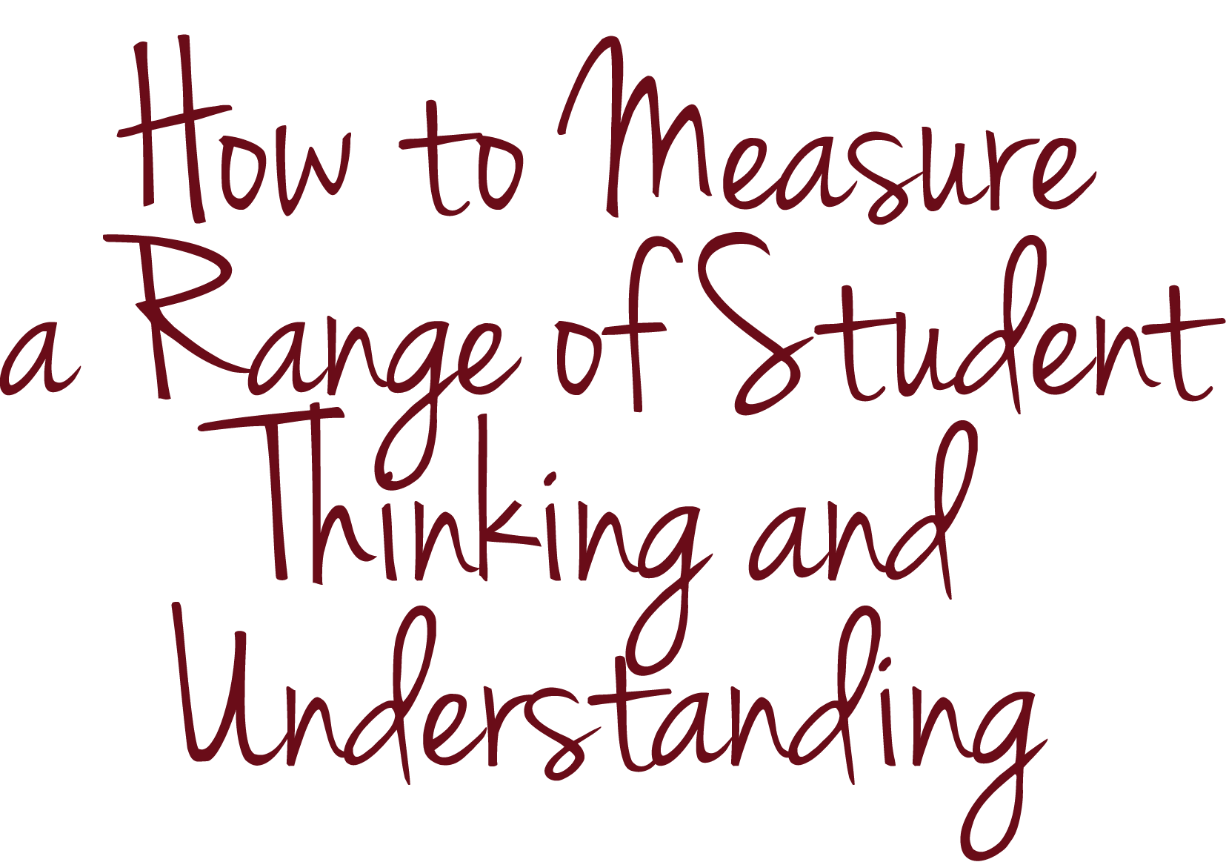
KEY CONCEPTS

Slide 36
KEY CONCEPTS
Notes:
In addition to each assessment item matching the level of rigor of the skill you intend to measure, an assessment with an appropriate level of rigor measures a range of student thinking and understanding so that it measures what all students know and can do. If assessments are too easy, some students may not have the opportunity to demonstrate the upper bounds of what they know and can do. Assessments should include items that challenge all students. You may refer to these questions as “stretch” questions because they require students to push themselves to the upper bounds of what they know and can do. On the other hand, if assessments are too complex, some students may not be able to showcase their knowledge and skills at all. Assessments should include items that require lower-level thinking to reveal where learning breaks down among students struggling to master a standard.

Slide 37
KEY CONCEPTS
Notes:
You can organize items sequentially in order of difficulty so that students can feel successful early in the assessment and more challenged as they progress. You might include the most difficult questions in a separate bonus section to motivate more advanced students and not discourage others.

Slide 38
KEY CONCEPTS
The student solves problems involving direct proportional relationships. The student is expected to estimate and find solutions to application problems involving percent; and estimate and find solutions to application problems involving proportional relationships such as similarity, scaling, unit costs, and related measurement units.
Source: Texas Education Agency Student Assessment Division, “Grade 7 Mathematics Assessment” (2010).
Notes:
For example, let’s look at an assessment based on a seventh-grade mathematics standard from Texas that addresses percentages.
The standard reads:
The student solves problems involving direct proportional relationships. The student is expected to estimate and find solutions to application problems involving percent; and estimate and find solutions to application problems involving proportional relationships such as similarity, scaling, unit costs, and related measurement units.

Slide 39
KEY CONCEPTS
The student solves problems involving direct proportional relationships. The student is expected to estimate and find solutions to application problems involving percent; and estimate and find solutions to application problems involving proportional relationships such as similarity, scaling, unit costs, and related measurement units.
Notes:
You might measure a range of levels of rigor with an assessment aligned with this standard.

Slide 40
KEY CONCEPTS
What is 67 percent of 81?
Shawn got 7 correct answers out of 10 possible answers on his science test. What percentage of questions did he answer correctly?
Adam was on pace to set a high-school basketball record for free throw percentage. Going into his senior year, he had made 97 of 104 free throw attempts. What percentage of free throws had he made?
Adam and Jamie were competing for the best free throw percentage. Adam made 94 percent of his first 103 shots, whereas Jamie made 47 of 51 shots.
Which one had a better shooting percentage?
In the next game, Adam made only 2 of 10 shots, and Jamie made 7 of 10 shots. What are their new overall shooting percentages? Who is the better shooter?
Christine argued that if Adam and Jamie each made their next 10 shots, their shooting percentages would go up the same amount. Is this true? Why or why not? Describe in detail how you arrived at your answers.
Source: Paul Bambrick-Santoyo, “Data in the Driver’s Seat” (2007–2008).
Notes:
For example, notice how these assessment items gradually increase in rigor.
The assessment starts with a question that requires lower-ordering thinking, that is, “What is 67 percent of 81?” and ends with a question that requires higher-order thinking, that is, “Christine argued that if Adam and Jamie each made their next 10 shots, their shooting percentages would go up the same amount. Is this true? Why or why not? Describe in detail how you arrived at your answers.

Slide 41
KEY CONCEPTS
The student solves problems involving direct proportional relationships. The student is expected to estimate and find solutions to application problems involving percent; and estimate and find solutions to application problems involving proportional relationships such as similarity, scaling, unit costs, and related measurement units.
Notes:
One of the main verbs in this standard is “solve,” which, according to Webb’s Depth of Knowledge levels, requires lower-order thinking. The standard also indicates that students should be able to estimate and find solutions to application problems involving percent and proportional relationships, which calls for higher-order thinking.
This assessment includes some straightforward calculation problems that can help you identify students who may not understand how to calculate percentages and students who got lost at a later step in the multi-step problem.

Slide 42
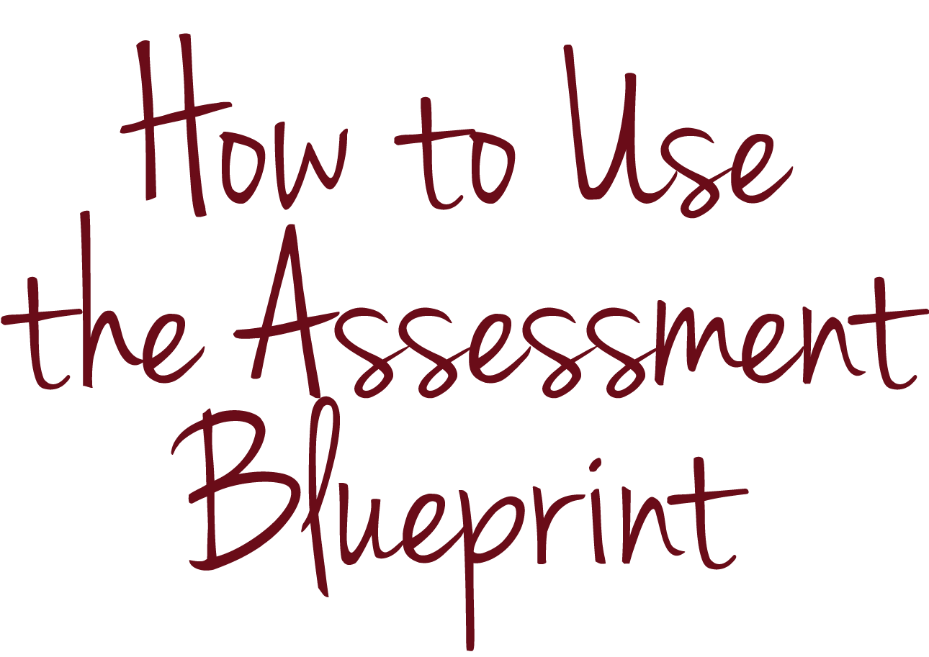
KEY CONCEPTS
Notes:
Let’s use the assessment blueprint and assessment blueprint example to document the level of rigor in several skills and identify possible types of assessment items you might use to measure those skills.

Slide 43
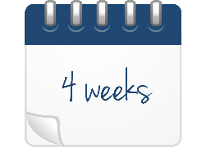
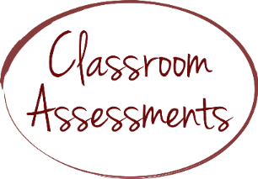
KEY CONCEPTS
Sources: Ohio Department of Education, “Ohio’s New Learning Standards: English Language Standards” (2010); Student Achievement Partners, “Mini-Assessment for Who Was Marco Polo? by Joan Holub and The Adventures of Marco Polo by Russell Freedman” (2014).
Notes:
Imagine that you are a fifth-grade teacher planning a unit focused on reading and writing about informational texts. You expect the unit to last approximately four weeks.

Slide 44
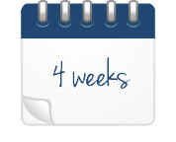
KEY CONCEPTS
Notes:
At the end of the unit, you plan to use a summative assessment to measure how well your students have mastered the relevant standards.

Slide 45
KEY CONCEPTS
1. Primary Purpose of the Assessment |  |  |  | Summative
2. Standard(s) (one per row) |  |  | 3. Skill(s) (one per row) | 4. Level(s) of Rigor | 5. Possible Type(s) of Items
Reading Informational Text 1: Quote accurately from a text when explaining what the text says explicitly and when drawing inferences from the text. |  |  | Quote accurately from the text (explicitly and making inferences).
Reading Informational Text 2: Determine two or more main ideas of a text and explain how they are supported by key details; summarize the text. |  |  | Identify main ideas and how key details support them.
Reading Informational Text 4: Determine the meaning of general academic and domain-specific words and phrases in a text relevant to a grade 5 topic or subject area. |  |  | Determine the meaning of new vocabulary words.
Reading Informational Text 8: Explain how an author uses reasons and evidence to support particular points in a text, identifying which reasons and evidence support which point(s). |  |  | Explain how the author uses evidence to support his or her claims.
Writing 1: Write opinion pieces on topics or texts, supporting a point of view with reasons and information. |  |  | Write an opinion piece on texts.
 |  |  | Support your point of view with evidence.
6. Write and/or Select Assessment Items
Item # | Standard(s) and/or Skill(s) | Type of Item | Level(s) of Rigor | # of Points | % of Assessment
TOTAL
Notes:
You have determined that the unit will focus on four reading informational text standards and one writing standard. You have “unpacked” the standards to identify and paraphrase the skills you plan to teach and assess.

Slide 46
KEY CONCEPTS
1. Primary Purpose of the Assessment |  |  |  | Summative
2. Standard(s) (one per row) |  |  | 3. Skill(s) (one per row) | 4. Level(s) of Rigor | 5. Possible Type(s) of Items
Reading Informational Text 1: Quote accurately from a text when explaining what the text says explicitly and when drawing inferences from the text. |  |  | Quote accurately from the text (explicitly and making inferences).
Reading Informational Text 2: Determine two or more main ideas of a text and explain how they are supported by key details; summarize the text. |  |  | Identify main ideas and how key details support them.
Reading Informational Text 4: Determine the meaning of general academic and domain-specific words and phrases in a text relevant to a grade 5 topic or subject area. |  |  | Determine the meaning of new vocabulary words.
Reading Informational Text 8: Explain how an author uses reasons and evidence to support particular points in a text, identifying which reasons and evidence support which point(s). |  |  | Explain how the author uses evidence to support his or her claims.
Writing 1: Write opinion pieces on topics or texts, supporting a point of view with reasons and information. |  |  | Write an opinion piece on texts.
 |  |  | Support your point of view with evidence.
6. Write and/or Select Assessment Items
Item # | Standard(s) and/or Skill(s) | Type of Item | Level(s) of Rigor | # of Points | % of Assessment
TOTAL
Notes:
Step 4 of the assessment blueprint asks you to identify the level(s) of rigor of each standard or skill you plan to assess.

Slide 47
KEY CONCEPTS
3. Skill(s) (one per row) | 4. Level(s) of Rigor
Quote accurately from the text (explicitly and making inferences).
Identify main ideas and how key details support them.
Determine the meaning of new vocabulary words.
Explain how the author uses evidence to support his or her claims.
Write an opinion piece on texts.
Support your point of view with evidence.
Notes:
Try to use Webb’s Depth of Knowledge levels to identify the levels of rigor in each of these skill. Use the verbs in each standard and skill to guide you, but keep in mind that the meaning of the verbs, and therefore the levels of rigor, depend on the context of the standard.

Slide 48
KEY CONCEPTS
3. Skill(s) (one per row) | 4. Level(s) of Rigor
Quote accurately from the text (explicitly and making inferences).
Identify main ideas and how key details support them.
Determine the meaning of new vocabulary words.
Explain how the author uses evidence to support his or her claims.
Write an opinion piece on texts.
Support your point of view with evidence.
Notes:
Pause this video if you want a few moments to think about your answer or discuss it with colleagues.

Slide 49
KEY CONCEPTS
1. Primary Purpose of the Assessment |  |  |  | Summative
2. Standard(s) (one per row) |  |  | 3. Skill(s) (one per row) | 4. Level(s) of Rigor | 5. Possible Type(s) of Items
Reading Informational Text 1: Quote accurately from a text when explaining what the text says explicitly and when drawing inferences from the text. |  |  | Quote accurately from the text (explicitly and making inferences). | 1
Reading Informational Text 2: Determine two or more main ideas of a text and explain how they are supported by key details; summarize the text. |  |  | Identify main ideas and how key details support them. | 2
Reading Informational Text 4: Determine the meaning of general academic and domain-specific words and phrases in a text relevant to a grade 5 topic or subject area. |  |  | Determine the meaning of new vocabulary words. | 2
Reading Informational Text 8: Explain how an author uses reasons and evidence to support particular points in a text, identifying which reasons and evidence support which point(s). |  |  | Explain how the author uses evidence to support his or her claims. | 3
Writing 1: Write opinion pieces on topics or texts, supporting a point of view with reasons and information. |  |  | Write an opinion piece on texts. | 3
 |  |  | Support your point of view with evidence. | 3
6. Write and/or Select Assessment Items
Item # | Standard(s) and/or Skill(s) | Type of Item | Level(s) of Rigor | # of Points | % of Assessment
TOTAL
Notes:
We suggest that the levels of rigor for each of the six skills are 1, 2, 2, 3, 3 and 3, respectively. You may have reached a slightly different conclusion, and that’s okay. What’s important is taking the time to consider the level of rigor of each skill you will assess, not getting the “right answer” or filling out the blueprint template for its own sake. In this case, the process you go through to determine the level of rigor for each skill on your assessment can help you even better understand the content of the standards you plan to assess and teach.

Slide 50
KEY CONCEPTS
1. Primary Purpose of the Assessment |  |  |  | Summative
2. Standard(s) (one per row) |  |  | 3. Skill(s) (one per row) | 4. Level(s) of Rigor | 5. Possible Type(s) of Items
Reading Informational Text 1: Quote accurately from a text when explaining what the text says explicitly and when drawing inferences from the text. |  |  | Quote accurately from the text (explicitly and making inferences). | 1
Reading Informational Text 2: Determine two or more main ideas of a text and explain how they are supported by key details; summarize the text. |  |  | Identify main ideas and how key details support them. | 2
Reading Informational Text 4: Determine the meaning of general academic and domain-specific words and phrases in a text relevant to a grade 5 topic or subject area. |  |  | Determine the meaning of new vocabulary words. | 2
Reading Informational Text 8: Explain how an author uses reasons and evidence to support particular points in a text, identifying which reasons and evidence support which point(s). |  |  | Explain how the author uses evidence to support his or her claims. | 3
Writing 1: Write opinion pieces on topics or texts, supporting a point of view with reasons and information. |  |  | Write an opinion piece on texts. | 3
 |  |  | Support your point of view with evidence. | 3
6. Write and/or Select Assessment Items
Item # | Standard(s) and/or Skill(s) | Type of Item | Level(s) of Rigor | # of Points | % of Assessment
TOTAL
Notes:
Once you determine the level(s) of rigor within a standard, you can consider the implications for how best to assess that standard.

Slide 51
KEY CONCEPTS
Notes:
Higher-order cognitive skills lend themselves more to robust assessment types like constructed-response items and performance tasks.

Slide 52
KEY CONCEPTS
1. Primary Purpose of the Assessment |  |  |  | Summative
2. Standard(s) (one per row) |  |  | 3. Skill(s) (one per row) | 4. Level(s) of Rigor | 5. Possible Type(s) of Items
Reading Informational Text 1: Quote accurately from a text when explaining what the text says explicitly and when drawing inferences from the text. |  |  | Quote accurately from the text (explicitly and making inferences). | 1 | SR
Reading Informational Text 2: Determine two or more main ideas of a text and explain how they are supported by key details; summarize the text. |  |  | Identify main ideas and how key details support them. | 2 | CR
Reading Informational Text 4: Determine the meaning of general academic and domain-specific words and phrases in a text relevant to a grade 5 topic or subject area. |  |  | Determine the meaning of new vocabulary words. | 2 | SR
Reading Informational Text 8: Explain how an author uses reasons and evidence to support particular points in a text, identifying which reasons and evidence support which point(s). |  |  | Explain how the author uses evidence to support his or her claims. | 4 | CR
Writing 1: Write opinion pieces on topics or texts, supporting a point of view with reasons and information. |  |  | Write an opinion piece on texts. | 5 | CR, PT
 |  |  | Support your point of view with evidence. | 5 | CR, PT
6. Write and/or Select Assessment Items
Item # | Standard(s) and/or Skill(s) | Type of Item | Level(s) of Rigor | # of Points | % of Assessment
TOTAL
Notes:
Step 5 of the blueprint asks you to document possible types of items you may use to assess each skill.

Slide 53
KEY CONCEPTS
1. Primary Purpose of the Assessment |  |  |  | Summative
2. Standard(s) (one per row) |  |  | 3. Skill(s) (one per row) | 4. Level(s) of Rigor | 5. Possible Type(s) of Items
Reading Informational Text 1: Quote accurately from a text when explaining what the text says explicitly and when drawing inferences from the text. |  |  | Quote accurately from the text (explicitly and making inferences). | 1 | SR
Reading Informational Text 2: Determine two or more main ideas of a text and explain how they are supported by key details; summarize the text. |  |  | Identify main ideas and how key details support them. | 2 | CR
Reading Informational Text 4: Determine the meaning of general academic and domain-specific words and phrases in a text relevant to a grade 5 topic or subject area. |  |  | Determine the meaning of new vocabulary words. | 2 | SR
Reading Informational Text 8: Explain how an author uses reasons and evidence to support particular points in a text, identifying which reasons and evidence support which point(s). |  |  | Explain how the author uses evidence to support his or her claims. | 4 | CR
Writing 1: Write opinion pieces on topics or texts, supporting a point of view with reasons and information. |  |  | Write an opinion piece on texts. | 5 | CR, PT
 |  |  | Support your point of view with evidence. | 5 | CR, PT
6. Write and/or Select Assessment Items
Item # | Standard(s) and/or Skill(s) | Type of Item | Level(s) of Rigor | # of Points | % of Assessment
TOTAL
Notes:
We suggest that you may use selected- and constructed-response items to address the first four skills and constructed-response items or performance tasks to address the final two. (Remember that to answer selected-response items, students select the correct answer from a list of options included in the item; to answer constructed-response items and to complete performance tasks, students perform tasks to demonstrate their mastery of particular skills.)

Slide 54
KEY CONCEPTS
Notes:
You can often efficiently assess lower-order skills through selected-response items and use constructed-response items and performance tasks to assess higher-order cognitive skills. However, this is not a hard and fast rule. You can also use a well-designed selected-response item to assess higher-order cognitive skills.

Slide 55
CHECK FOR UNDERSTANDING
Notes:
We have addressed the key concepts in this module, so let’s review our goals.

Slide 56
CHECK FOR UNDERSTANDING
Define what RIGOR means for the purpose of these modules
Use the VERBS in standards and tools that teachers have available to identify the COGNITIVE COMPLEXITY in standards
Explain why assessments with an appropriate level of rigor also measure a RANGE OF STUDENT THINKING AND UNDERSTANDING
Use the ASSESSMENT BLUEPRINT to document the level of rigor of each skill
Notes:
At the outset of the module, we set goals that you would be able to (1) define what rigor means for the purpose of these modules; (2) use the verbs in standards and tools that teachers have available to identify the cognitive complexity in the relevant standards; (3) explain why assessments with an appropriate level of rigor also measure for a range of student thinking and understanding; and (4) use the assessment blueprint to document the level of rigor of each skill you are measuring in assessments you write or select.

Slide 57
CHECK FOR UNDERSTANDING
Notes:
To determine whether we have achieved our goals, let’s check your understanding with two assessment items.

Slide 58
CHECK FOR UNDERSTANDING
Using Webb’s Depth of Knowledge levels, identify the level or levels of rigor in this standard from Iowa. Remember to pay close attention to the verbs.
Understand the use of geographic tools to locate and analyze information about people, places, and environments.
Source: Iowa Department of Education, “Iowa Core K-12 Social Studies” (2010).
Notes:
Here’s the first item:
Using Webb’s Depth of Knowledge levels, identify the level or levels of rigor in this standard from Iowa. Remember to pay close attention to the verbs.
Understand the use of geographic tools to locate and analyze information about people, places, and environments.

Slide 59
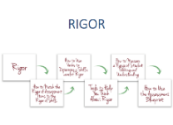
CHECK FOR UNDERSTANDING
Using Webb’s Depth of Knowledge levels, identify the level or levels of rigor in this standard from Iowa. Remember to pay close attention to the verbs.
Understand the use of geographic tools to locate and analyze information about people, places, and environments.
Notes:
Pause this video if you want a few moments to think about your answer or discuss it with colleagues.

Slide 60
CHECK FOR UNDERSTANDING
Using Webb’s Depth of Knowledge levels, identify the level or levels of rigor in this standard from Iowa. Remember to pay close attention to the verbs.
Understand the use of geographic tools to locate and analyze information about people, places, and environments.
The key verbs in the skills in this standard are “use” and “analyze,” which are associated with lower- and higher-order skills. “Understand” is a level 2 skill, and “analyze” is a level 4 skill.
Notes:
A sample answer to the first item would be: The key verbs in the skills in this standard are “use” and “analyze,” which are associated with lower- and higher-order skills. “Understand” is a level 2 skill, and “analyze” is a level 4 skill.

Slide 61
CHECK FOR UNDERSTANDING
Explain in your own words why well-designed assessments should measure a range of student thinking and understanding.
Notes:
Here’s the second item:
Explain in your own words why well-designed assessments should measure a range of student thinking and understanding.

Slide 62
CHECK FOR UNDERSTANDING
Explain in your own words why well-designed assessments should measure a range of student thinking and understanding.
Notes:
Pause this video if you want a few moments to think about your answer or discuss it with colleagues.

Slide 63
CHECK FOR UNDERSTANDING
Explain in your own words why well-designed assessments should measure a range of student thinking and understanding.
Well-designed assessments include items with various levels of rigor to ensure that they measure what all students know and can do. If assessments are too easy, some students may not have the opportunity to demonstrate the upper bounds of what they know and can do. I should include items in my assessment that challenge all of my students.
On the other hand, if assessments are too complex, some students may not be able to showcase their knowledge and skills at all. I can include items that require lower-level thinking to reveal where learning breaks down among students struggling to master a standard.
Notes:
A sample answer to the second item would be: Well-designed assessments include items with various levels of rigor to ensure that they measure what all students know and can do. If assessments are too easy, some students may not have the opportunity to demonstrate the upper bounds of what they know and can do. I should include items in my assessment that challenge all of my students. On the other hand, if assessments are too complex, some students may not be able to showcase their knowledge and skills at all. I can include items that require lower-level thinking to reveal where learning breaks down among students struggling to master a standard.

Slide 64
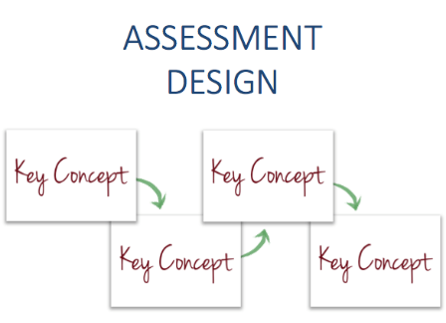
CONCLUSION
Notes:
Good work! Thank you for completing the module on rigor. Please view additional modules to continue your learning.

